Slide 1
Champions program training #2
Sales Team:
Jim Bailey – National Specification Sales Manager
Clara Powell – Northeast Regional Sales Manager
Clay Edwards – Southeast Regional Sales Manager
Jim Bailey – West Regional Sales Manager
Rusty McBride – Midwest Regional Sales Manager
October 2025

Slide 2
Presentation 2 - Outline
  Champions Program Presentation #2:
  Quotation & Ordering review (Joelisa)
    Budget estimates vs orderable quoted pricing
    Quotations - inclusion/exclusions
  Installation overview and scope (Jim B)
  Identifying opportunities (Jim M)
    Competitors
    Div9/Div26
    Acoustics
  National Accounts Overview (Jason)

Slide 3
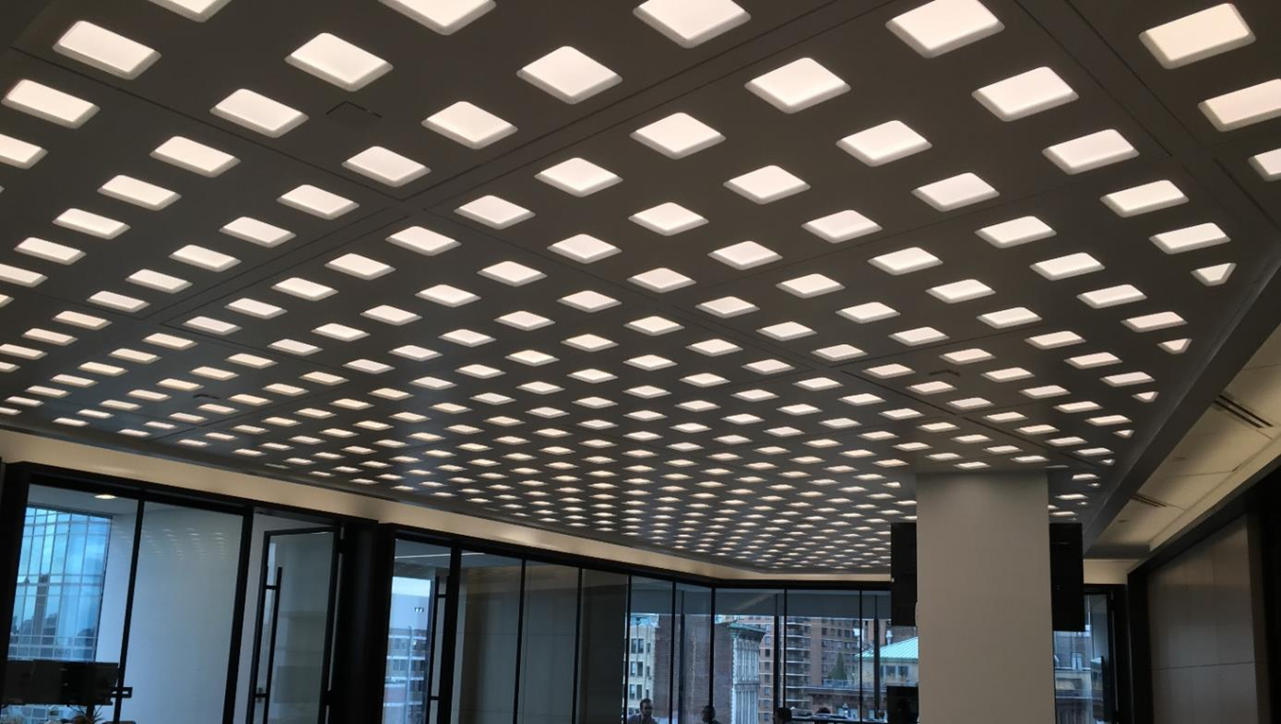
Pricing
Pricing & Ordering
Notes:
Clearly understand what Cooledge includes and how it is presented so you can compare pricing and place orders

Slide 4
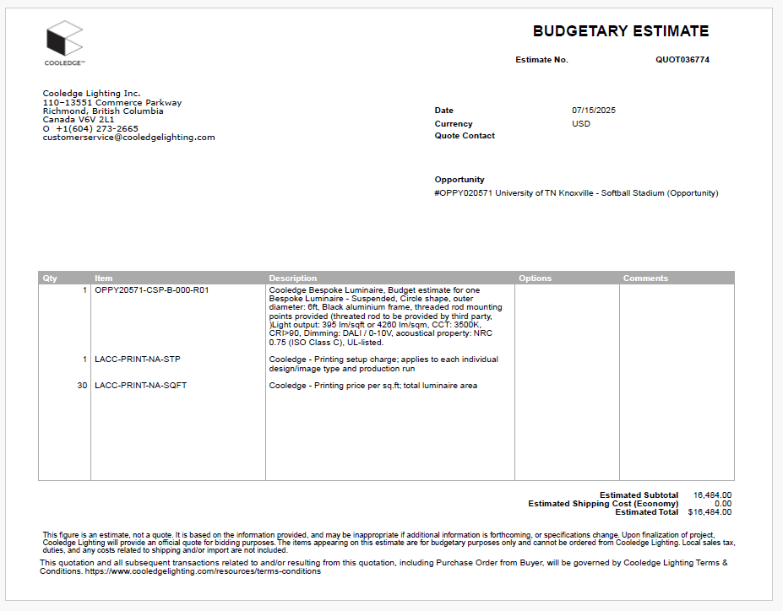
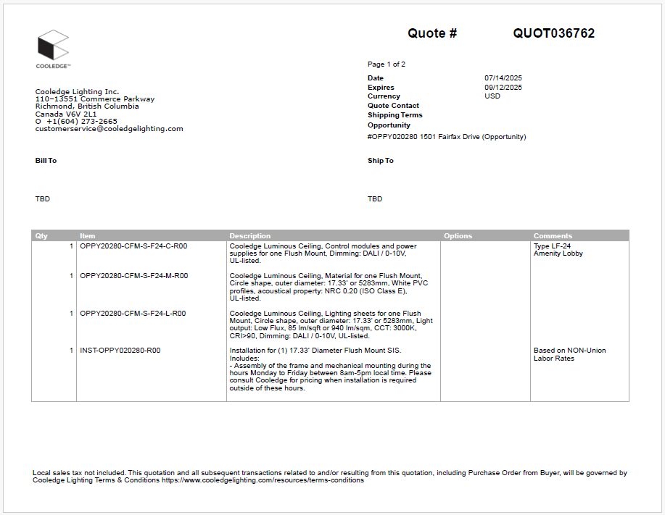
pricing
Budget Estimate
  “Budgetary Estimate” indicated in upper right-hand corner.
  Budget pricing for initial bids.
    Spec. or bid phase of project (limited details)
  Not orderable pricing
  No expiration date
Quoted Pricing
“Quote # indicated in upper right-hand corner
Accurate pricing with complete BOM, dimensions, controls and light output.
Valid for 60 days
May include optional “Extended Warranty” (additional 2 years)

Slide 5
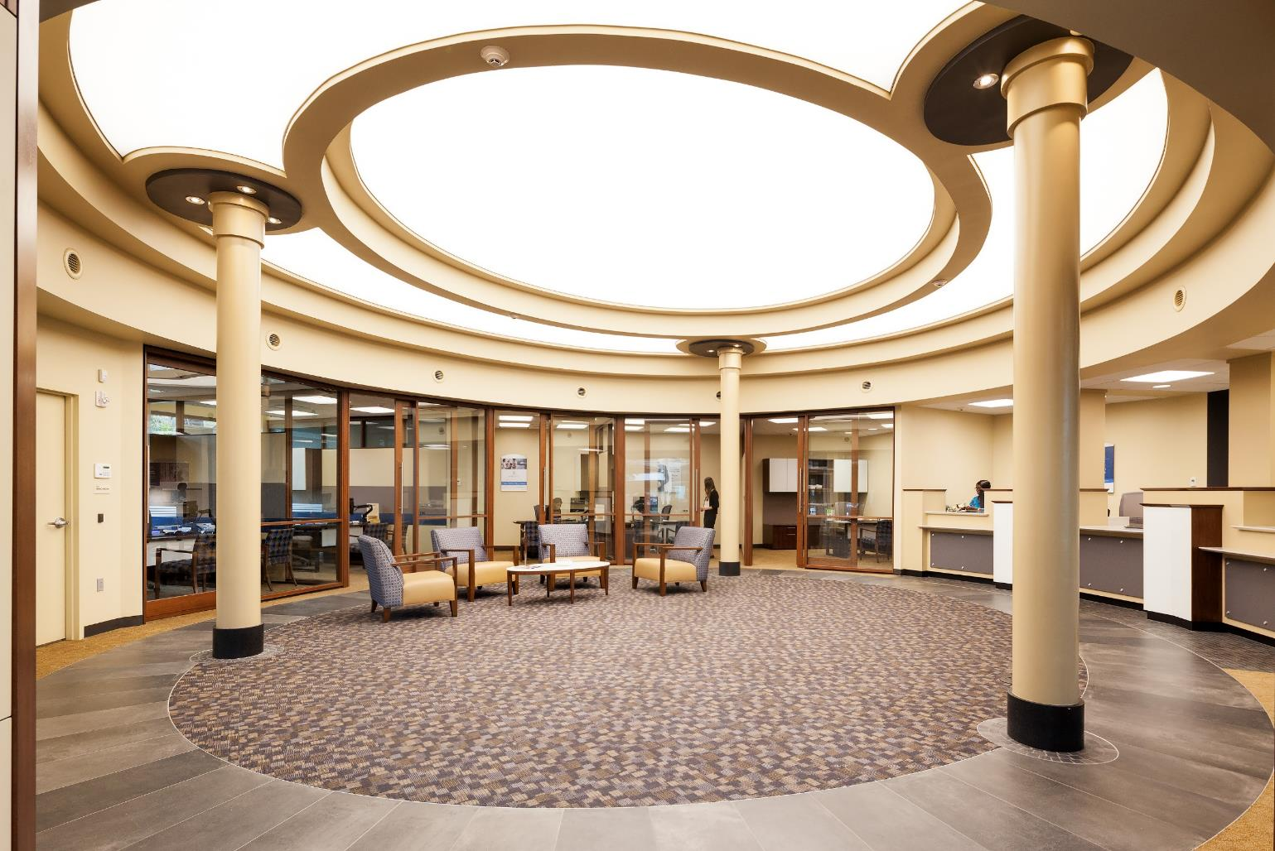
Quote requirements
Budget Requests (Ideal)
  Product Type (SkySpan, Bespoke, FABRILum, SkyLine, Lighting Systems)
  Mounting
  CCT, TWN, DTW, W+RGB
  Lumen Package
  Frame Color
  Controls
  Shape (Rectangle, Curved Corners, Circle, Curves, etc.)
  Dimensions
  Quantities
  Specifier
  Location (City & State)
  Interruptions (Shelves, Standoffs, etc.)
  Penetrations (Sprinkler, Pillars, etc.)
  EM Circuits
Orderable Quoted Pricing
Architectural Drawings
Fixture Schedule
Stage (Design, Bid, Buy)
Project Schedule

Slide 6
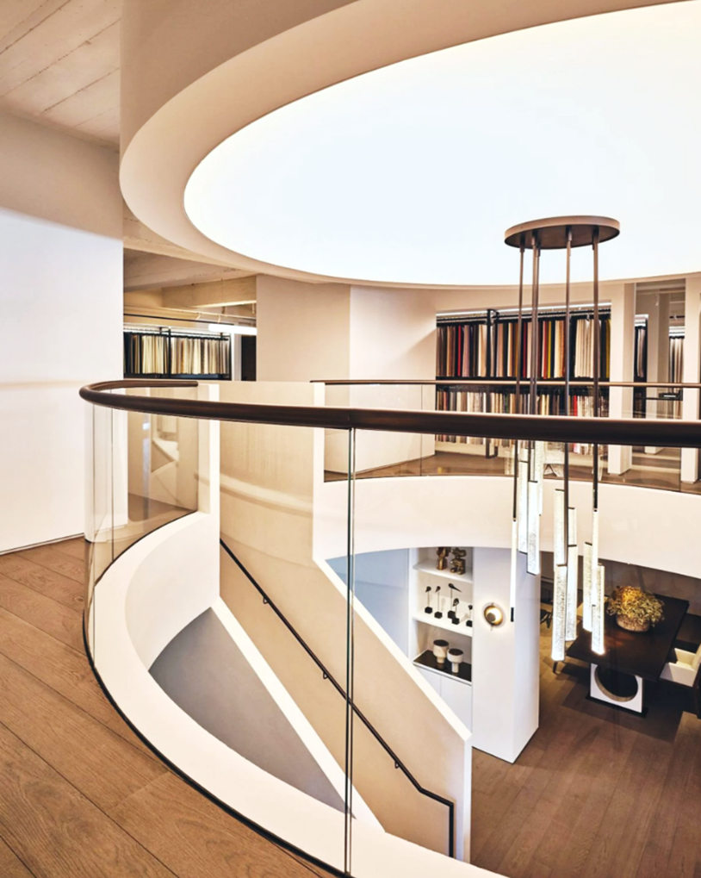
SkyLine, Skyspan - pricing inclusions
Commission Policy:
Commissions – 15% All Fixtures & Labor, 10% Lighting Systems
Overage - 60%/40% capped at 25% of order value
Extended Warranty 3%
SkySpan
Flush Mount, Surface and Suspended
  Freight, Tariffs, Profile and fabric installation
  Assembly and mounting of frame
  TILE installation (Optional)
  Union/Non-Union Labor
  Suspended mounting locations provide for threaded rod
SkyLine
Surface and Suspended
  Freight, Tariffs
  Union/Non-Union Labor (assembly and installation)
  Mounting locations provided for threaded rod

Slide 7
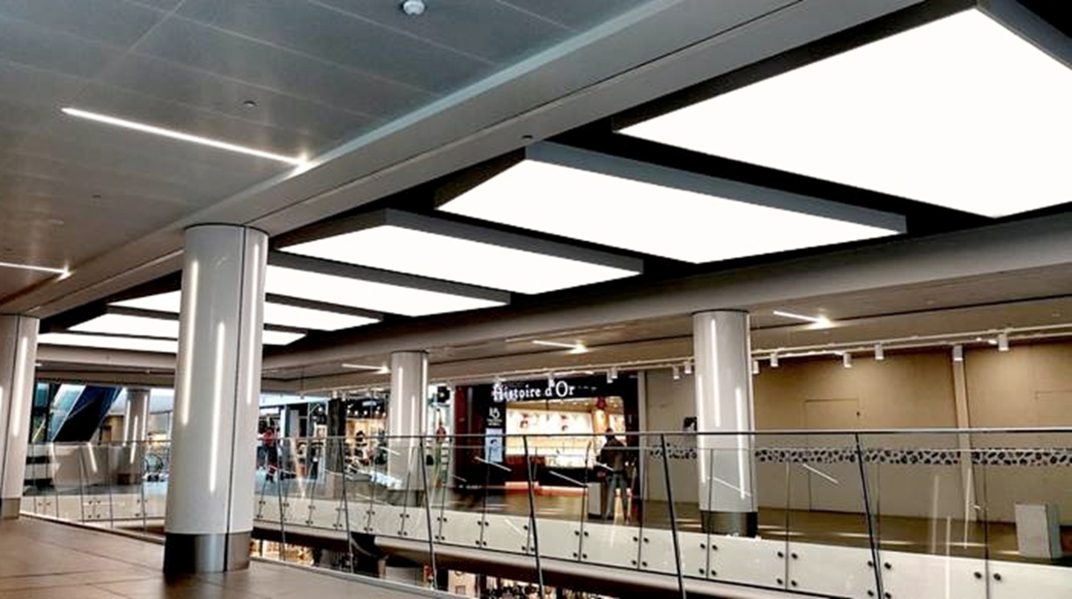
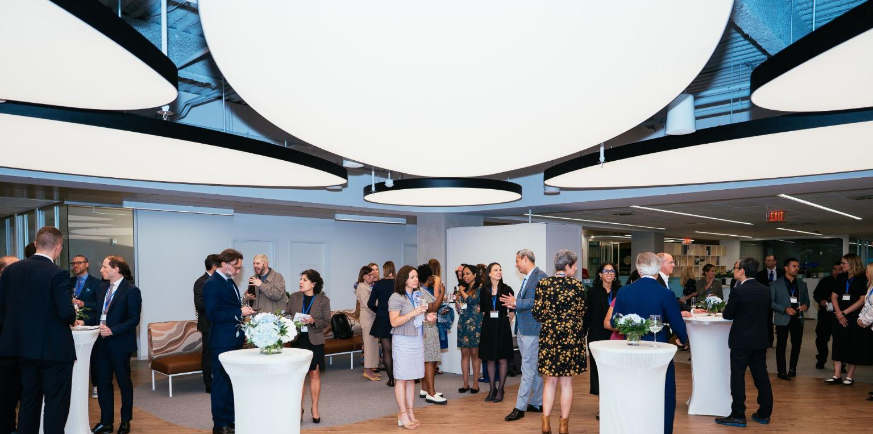
SkyLine and Skyspan - pricing exclusions
Cooledge Pricing Does Not Include:
SkySpan
Remote mounting of drivers or control modules
Electrical connections to power supplies and control modules to fixture
Low voltage wiring or connections to fixtures
2 Lifts or scaffolding
Construction of recessed cavity (Flush Mount)
Threaded Rod for suspended fixtures (Suspended)
SkyLine
Remote mounting of drivers or control modules
Electrical connections to power supplies and control modules to fixtures
2 Lifts or scaffolding
Threaded Rod for suspended fixtures

Slide 8
Ordering Guidelines
Hold For Release Orders
Prompts Design Team to develop submittals (SkySpan, Bespoke, and SkyLine)
Does not necessarily lock in pricing (Budget Quote)
Released Orders (Pending Approval)
Require approved submittal, 50% deposit, and complete BOM prior to ordering material and production (SkySpan, Bespoke, and SkyLine)
Orders Released to Fulfillment
No changes allowed
Non-cancellable
Cooledge to coordinate delivery and installation schedules (SkySpan and SkyLine)
POs addressed to: Cooledge Lighting, Inc.
110-13551 Commerce Parkway
Richmond, British Columbia
Canada V6V 2L1
Lighting Only and FABRILum Orders under $25K
Quoted and processed through CLDI
PO addressed to: Cooledge Lighting Distribution, Inc
PO Box 4319
Itasca, IL 60143

Slide 9
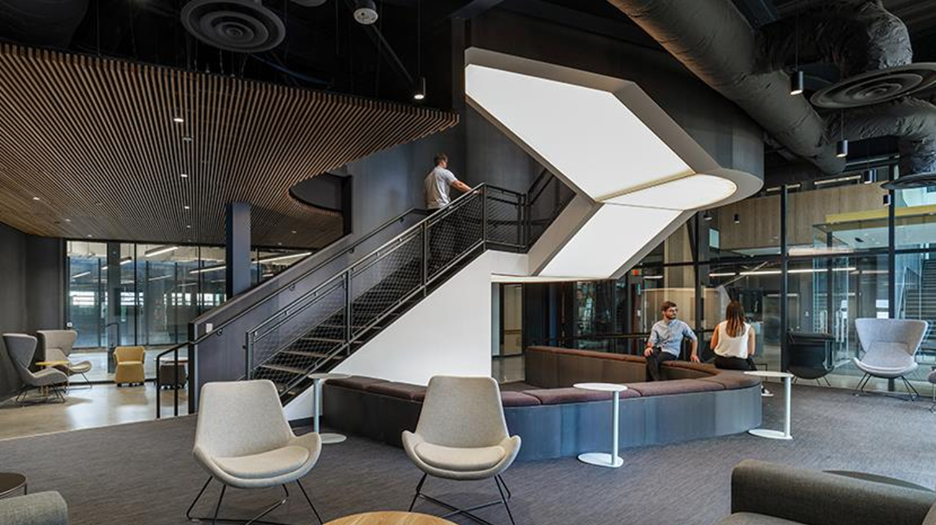
Installation
Scope & Installation

Slide 10
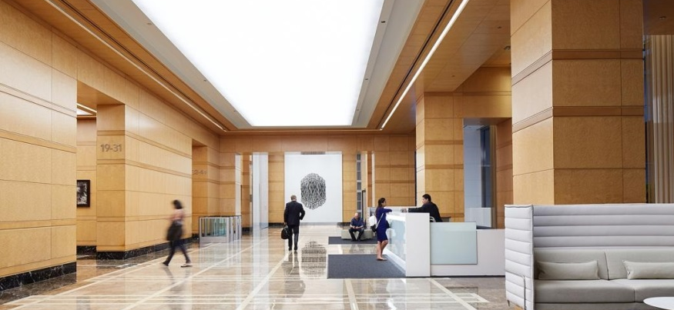
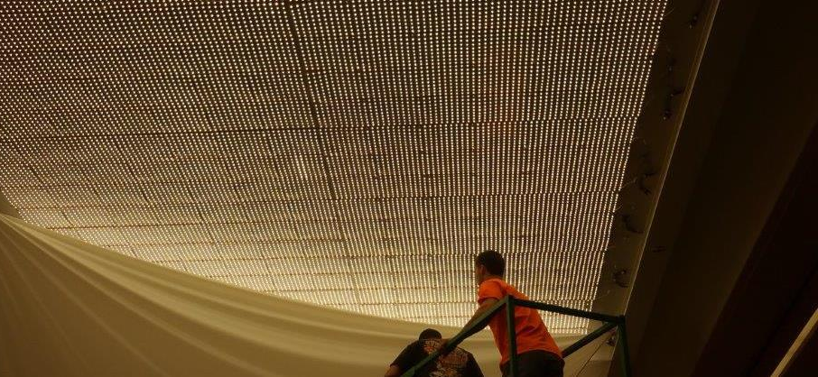
Flush Mount Installation
Cooledge PM will coordinate with the site to schedule installation
Cooledge installers will stretch fabric on the jobsite
Cooledge provides an option for TILE installation
Cooledge offers union and non-union installation partners

Slide 11
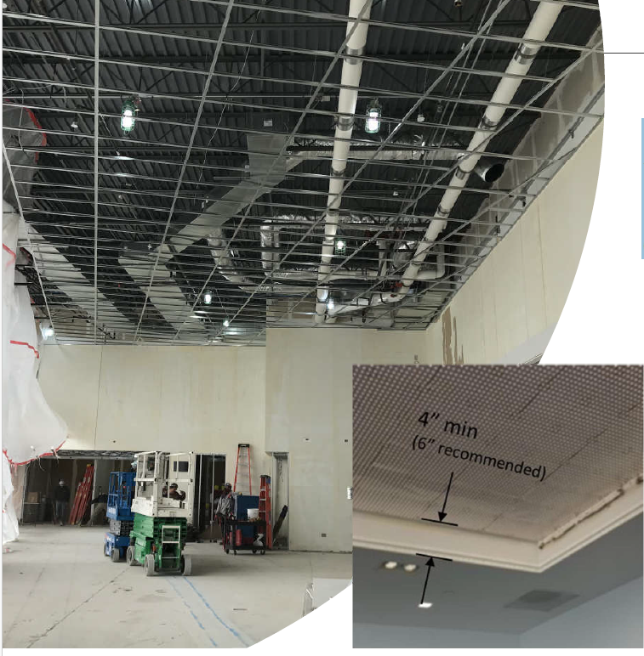
Flush mount installation
SOFFIT
INSTALLATION
(GENERAL CONTRACTOR SCOPE)
Gypsum (or other) soffit with finished corners
4” – 6” Ideal Soffit Depth
Built to withstand 20lb/lf tension force from fabric
Level 4 or 5 finish on soffit walls – should be smooth and straight.
Soffit walls painted white
Provide at least 2 dedicated lifts

Slide 12
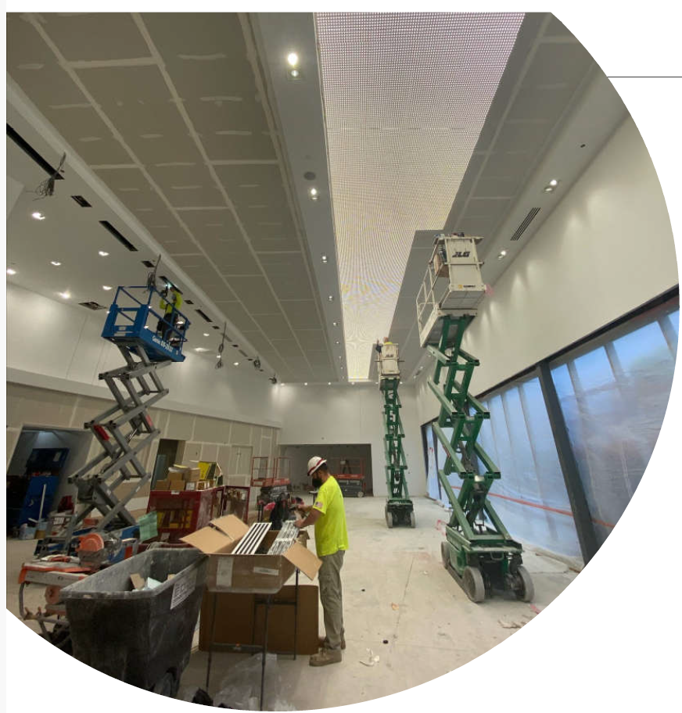
Tile installation
LED TILE INSTALLATION
(ELECTRICAL CONTRACTOR SCOPE)
Install according to Cooledge-provided lighting layout (Cooledge installation optional)
Remote wiring distances (distance from power supplies and control modules to the soffit) need to be considered – additional low voltage wire may be required.
Wiring must be tucked up away from profiles and LED TILESs
TILEs affixed to the substrate temporarily with double sided tape (TILE ships with tape attached)
TILES permanently affixed to the substrate using screws or staples.
System tested to ensure proper wiring
Care must be taken by all trades not to damage exposed TILEs prior to the installation of the fabric

Slide 13
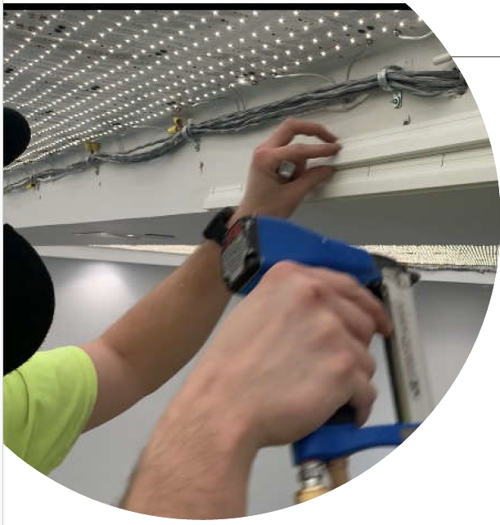
Profile Installation
PROFILE INSTALL
(COOLEDGE SCOPE)
Typically, at least two lifts required –
  Cooledge can quote lifts or provided by the GC
Track affixed with construction adhesive, screws and/or staples
Two layers of track (profile) – Dust ply (bug guard) and finish diffuser

Slide 14
Fabric installation
Cooledge Scope
Lifts required
Area needs to be clear, free of dust and debris
Two layers of fabric – Dust Ply and Diffuser
Cooledge stretch fabric is one of the last finishes to be installed.
* Appropriate scheduling is an important key to success.

Slide 15
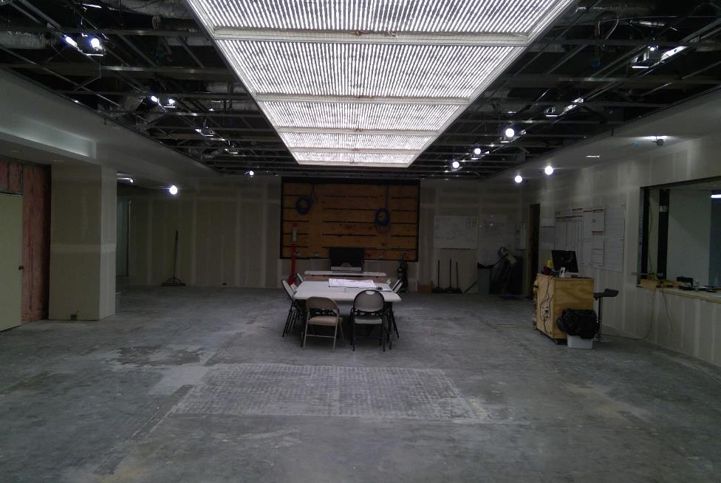
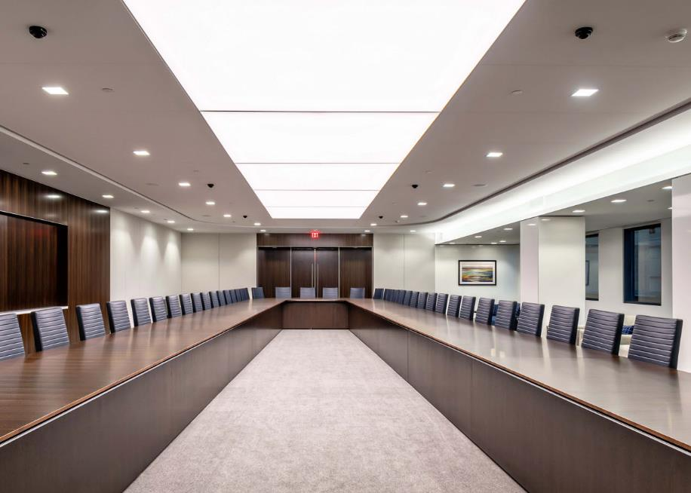
Methodist dallas medical center boardroom
Presentation Only – Not for Publication
ARCHITECT
Perkins + Will
CONTRACTOR
Skiles Group
CLIENT
MDMC
SIZE/AREA
SkySpan
8’ x 40’ (2.4m x 12.2m)
(5 sections of 8’ x 8’)
Notes:
Speaker Notes:

Slide 16
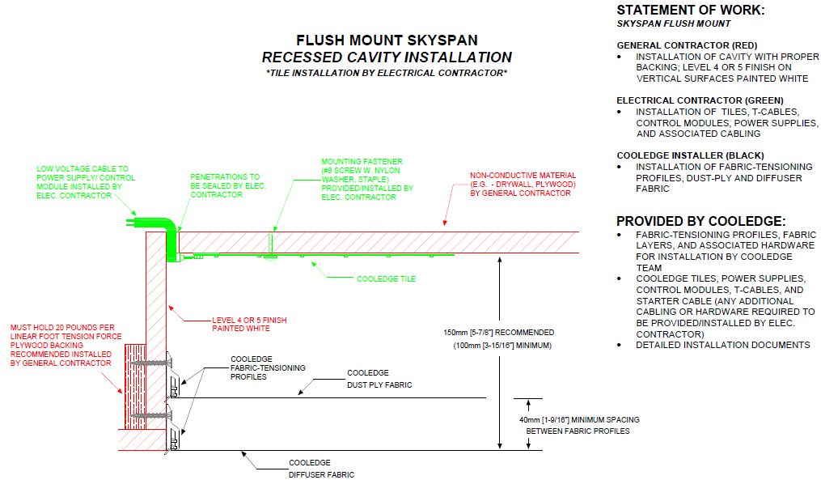
Flush mount - Ec tile installation

Slide 17
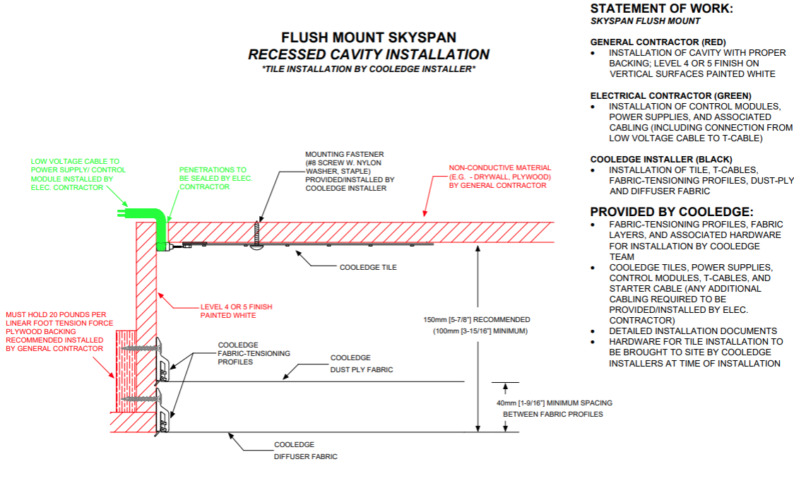
Flush mount – cooledge tile installation

Slide 18
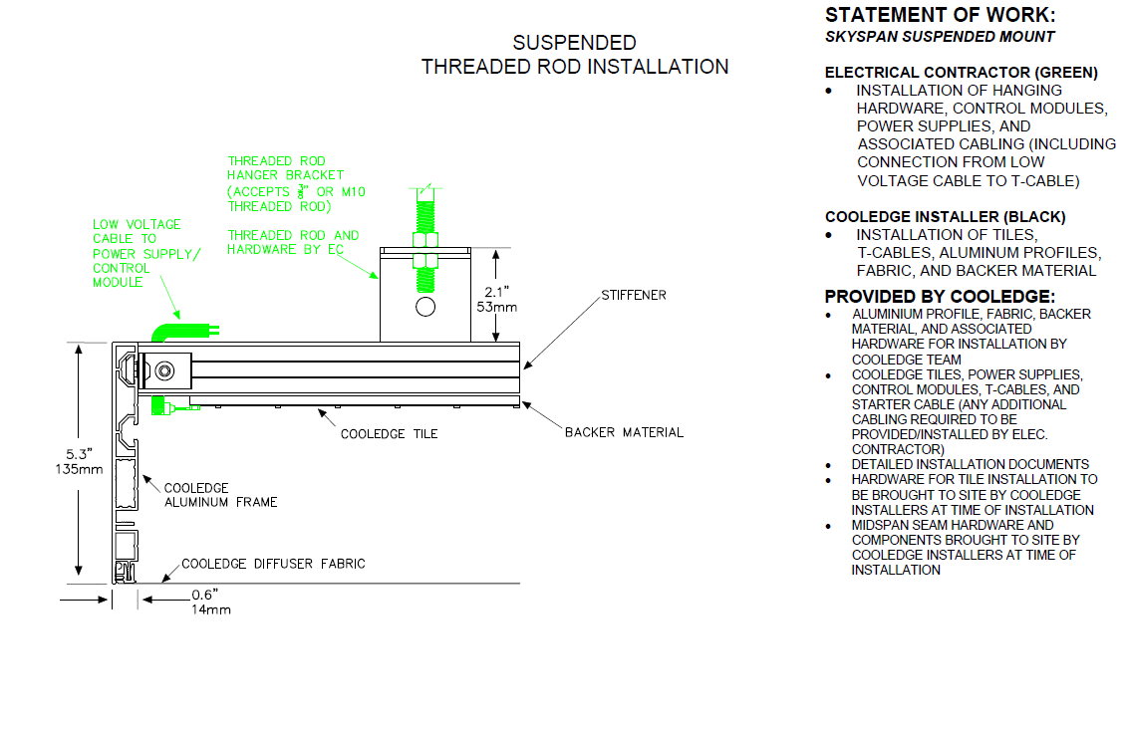
Suspended Skyspan

Slide 19
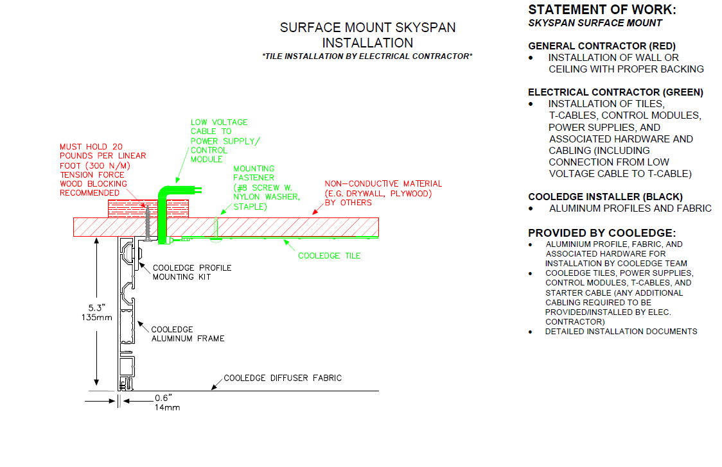
Surface Skyspan

Slide 20
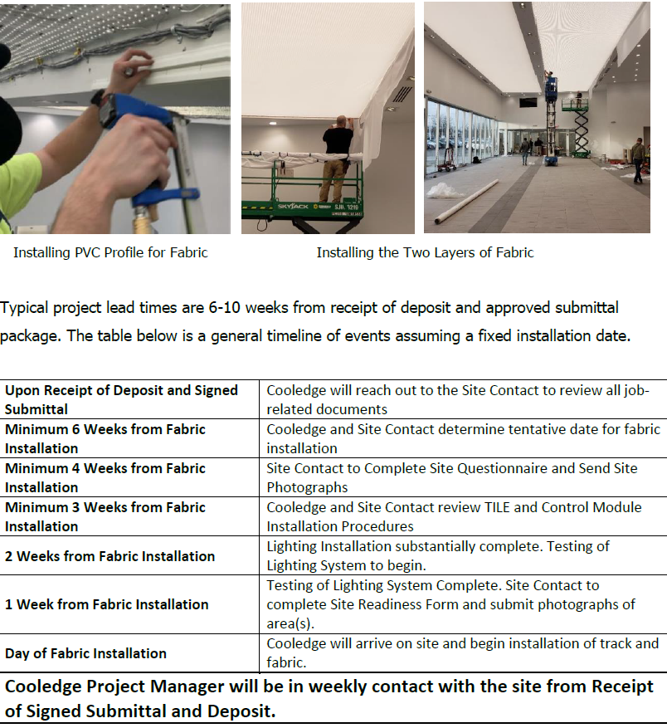
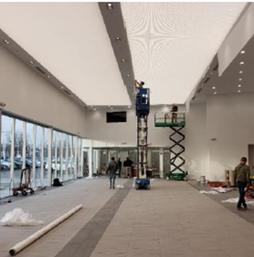
Flush mount timeline

Slide 21
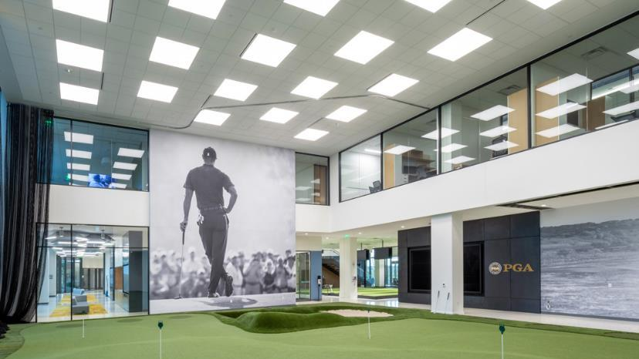
Opportunities
Opportunities
Notes:
Identify opportunities to increase your business and commissions by crossing existing specifications to Cooledge Lighting.

Slide 22










Competitors… opportunities to cross!!!
“Cieluma”

Slide 23
Competitors

Slide 24
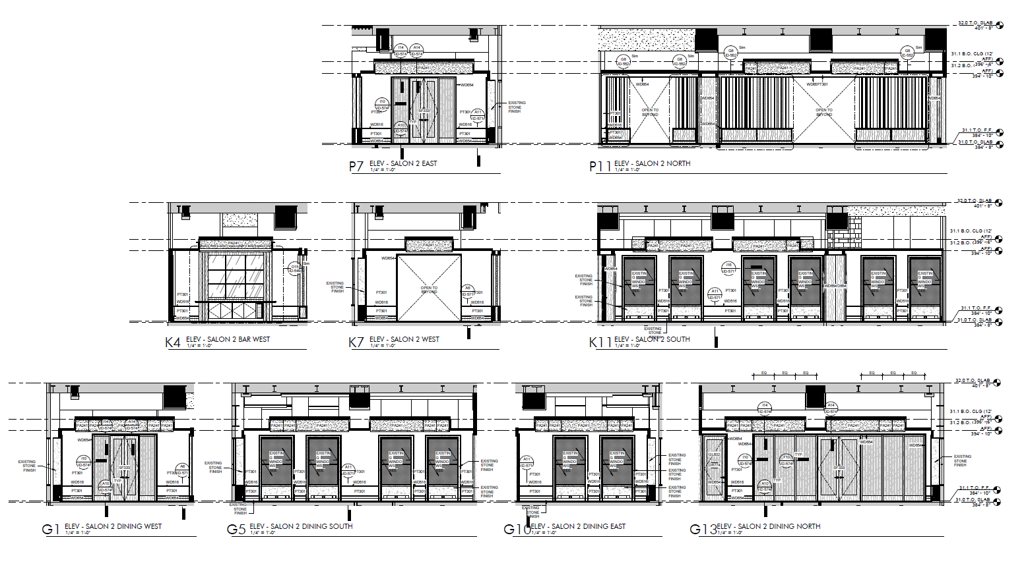
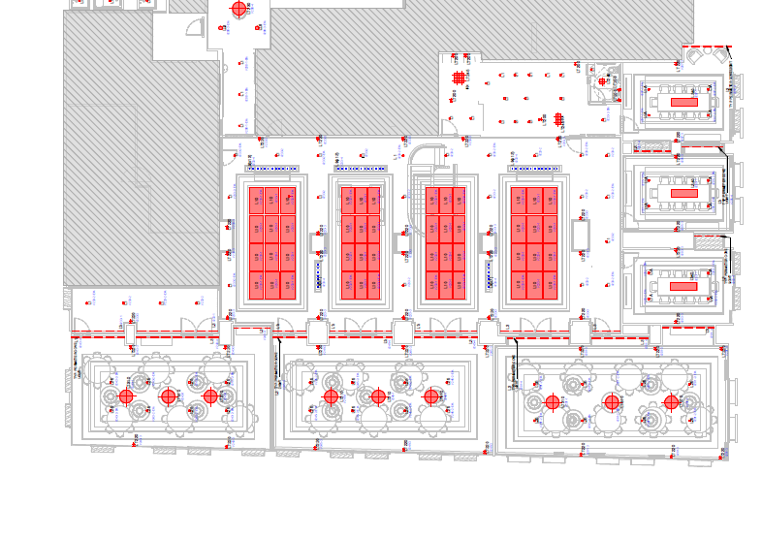
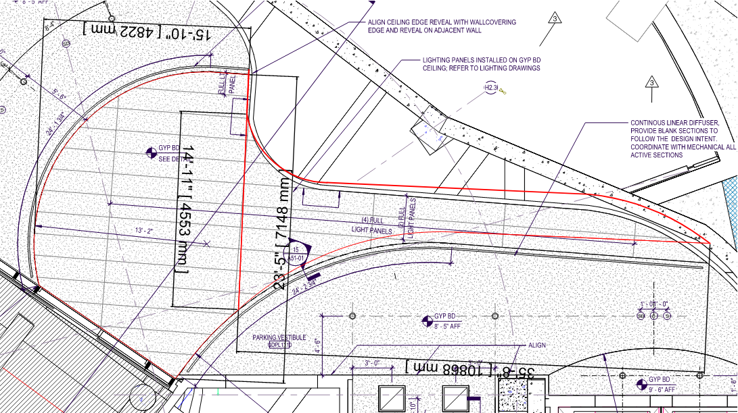
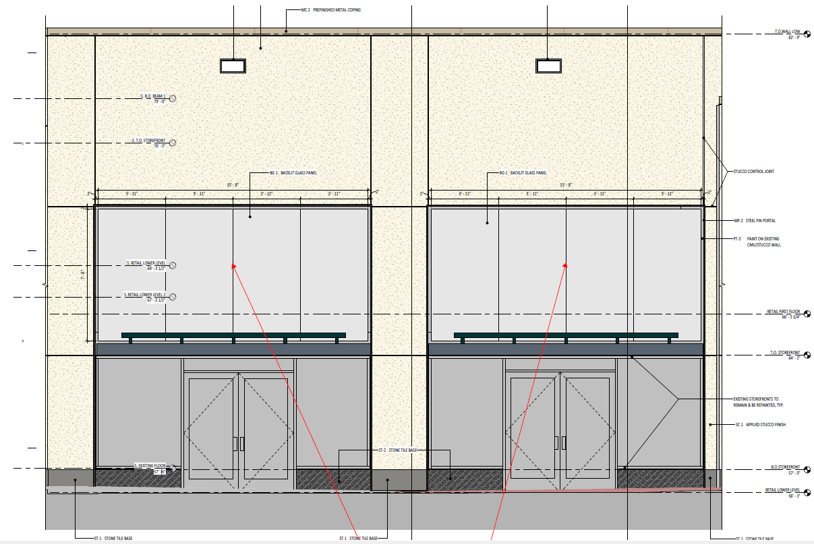
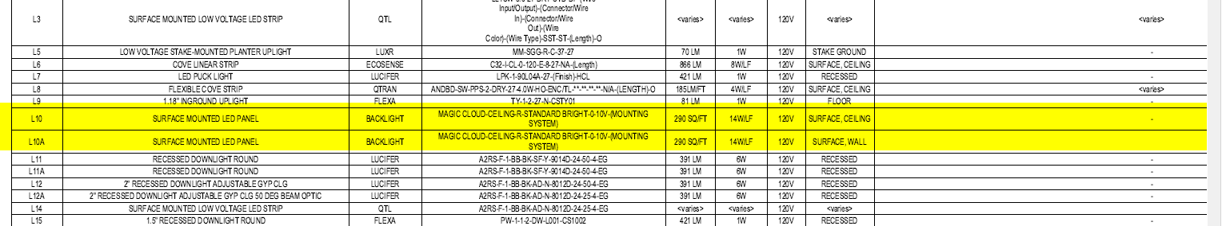



Luminous surface drawings
RCPs
Elevations
Schedule – Backlight Magic Cloud

Slide 25
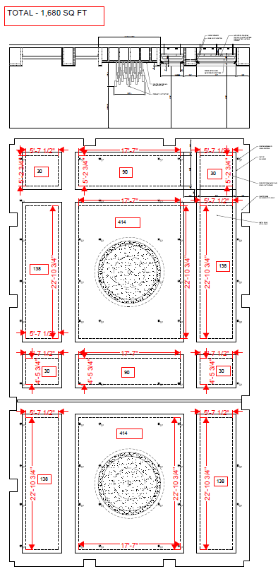

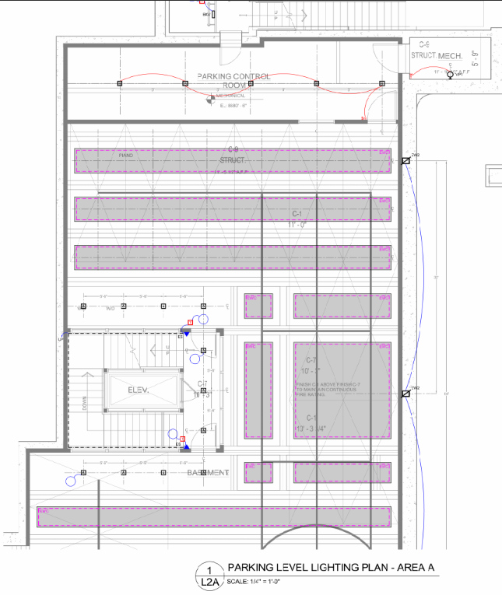
Luminous surface drawings

Slide 26
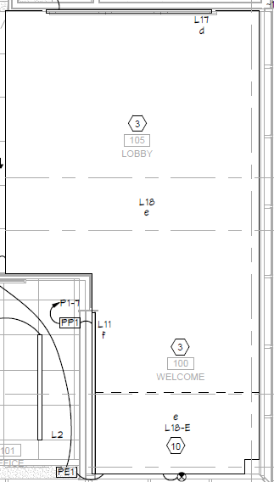
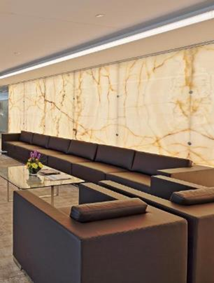
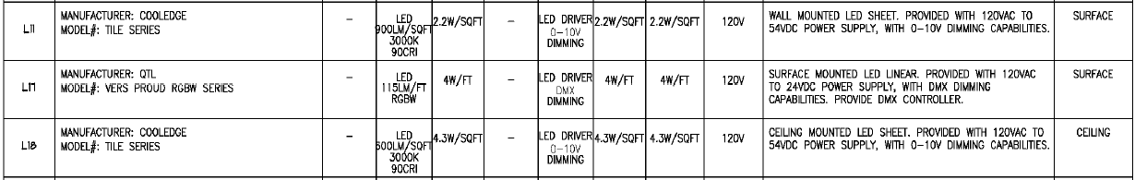




Wall mounted applications
* Elevation views required for all wall mounted installations to determine size, shape, and supports or penetrations.

Slide 27
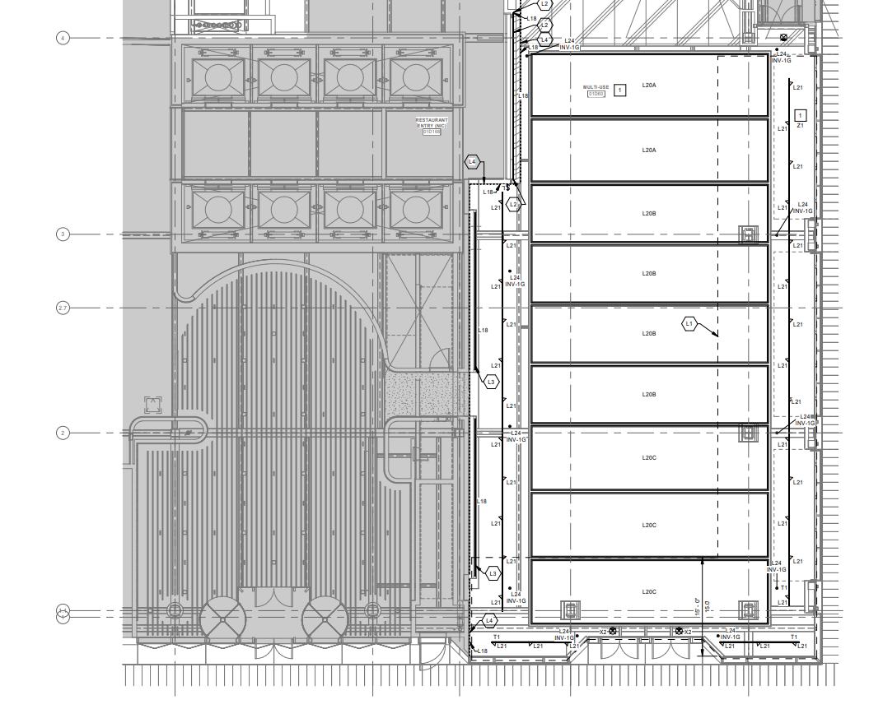
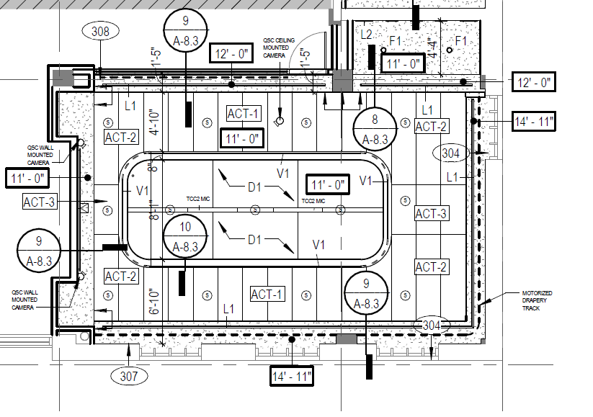
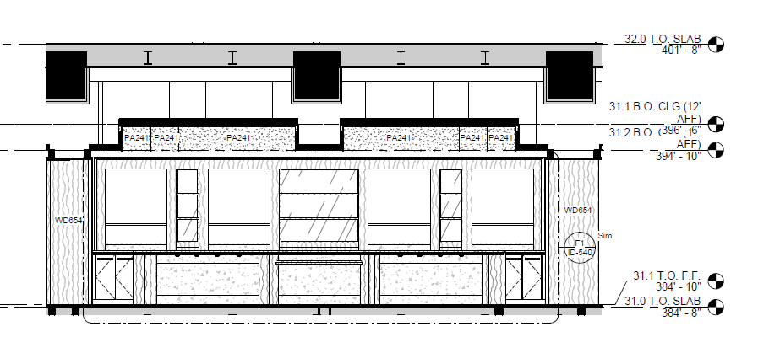








Drawings for Interruptions
* Make sure all interruptions are included on drawings to insure we quote the correct tiles.
Sprinkler Heads and Sensors
Columns
Backlighting Shelving

Slide 28
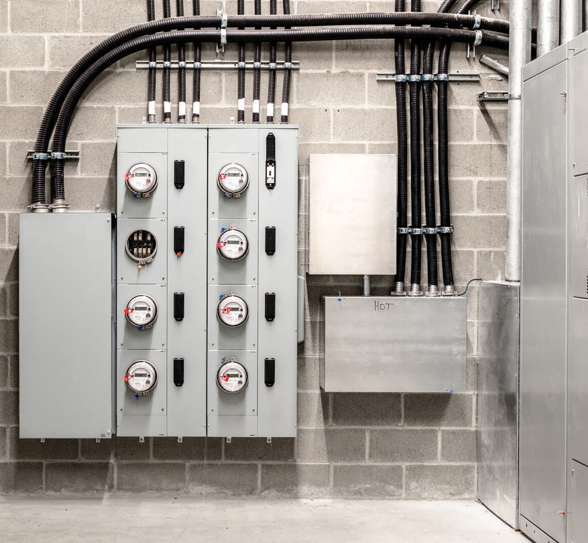
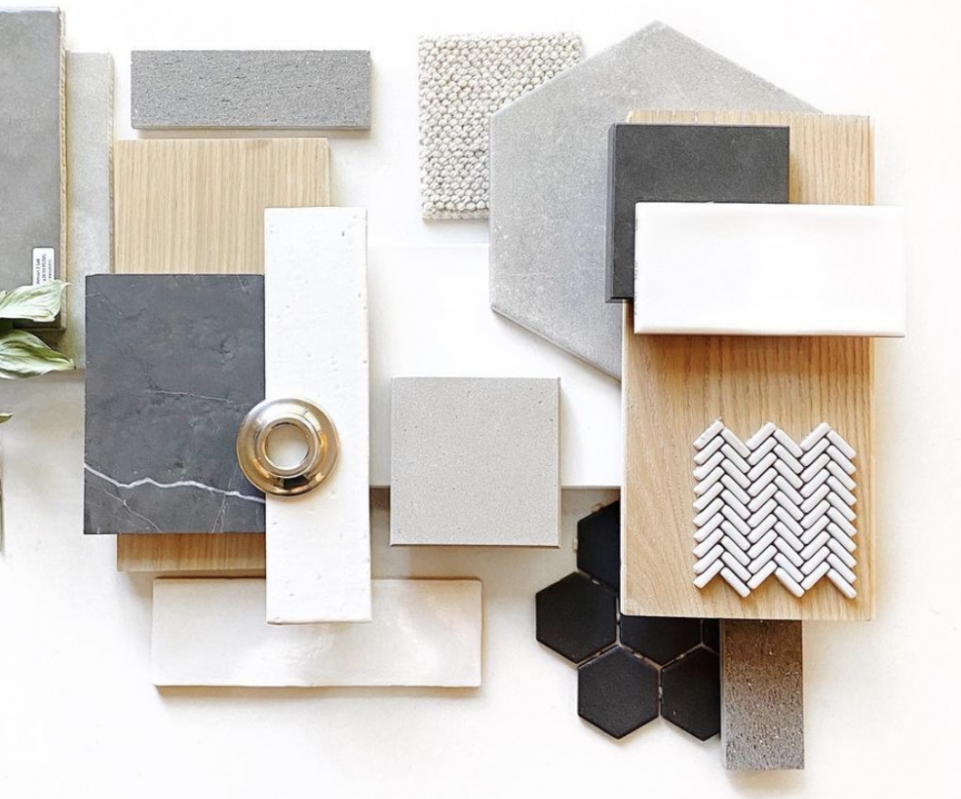
Where to find Stretch ceiling opportunities on Drawings
Division 26 Electrical is a set of electrical standards. It includes standards for site work excavation, wire & cable, boxes, underground duct banks and raceways, electrical identification, monitoring, control and distribution, programming, transformers, panelboards, motor controls, wiring devices, switches and breakers, emergency power and lighting.
Division 09 Finishes is devoted to the basic interior building blocks of a construction project. From walls to paint and ceilings to floors, Division 09 includes most common interior finishes.
Where to find opportunities in the drawing package:
Review A & E Drawings
  Stretch ceilings are not always listed on the E drawings.
  The A drawings should include needed mounting details.
Search for key words – Backlit, stretch ceiling, stretch, fabric, membrane, luminous surface, faux skylight, competitors names, printed graphic celing, perforated metal ceiling, light panels, etc.

Slide 29
luminous surfaces Terms and Definitions
Large Luminous Surface – Backlit wall or ceiling.
  May be referred to as: luminous surface, luminous ceiling, backlit, Skylight Fixture, Illumination Ceiling, Barrisol, Newmat, etc.
Hot Stretch – Typically PVC membrane installation requiring heat
Cold Stretch – Polyester or cotton fabric diffuser
Bespoke - Custom-designed complete fixtures tailored to specific requirements
Set Back – Distance from the light source (Tile) to the diffuser (Fabric or membrane)
Tiles – 1’x1’ or 1’x2’ flexible and cuttable LED light sheets
NRC – Noise Reduction Coefficient used for measuring sound absorption.
Sabin - A unit of acoustic absorption, representing the sound absorption of one sq. ft. of perfectly absorbing surface.

Slide 30
Hot stretch membrane vs. cold stretch fabric
Cold Stretch (Cooledge)
  Advantages:
    Does not require heat to install
    Partially removeable and reinstalled
    Circle weave makes piercings easier and
    prevents runs.
    Typically, less expensive
    Biodegradable options available
    Matte finish
  Disadvantages:
    Dry locations only
    More difficult to clean
      Isopropyl alcohol and microfiber cloth
Hot Stretch (Barrisol, Newmat, etc.)
  Advantages:
  Wet locations capable
  Easier to clean
  Antibacterial coatings.
  More finish and acoustical options available
    Micro-perf provides some diode exposure
  Disadvantages:
  Requires heat to install
  Tear risk when making piercings
  Typically, more expensive
  May require new membrane installation to access lighting

Slide 31
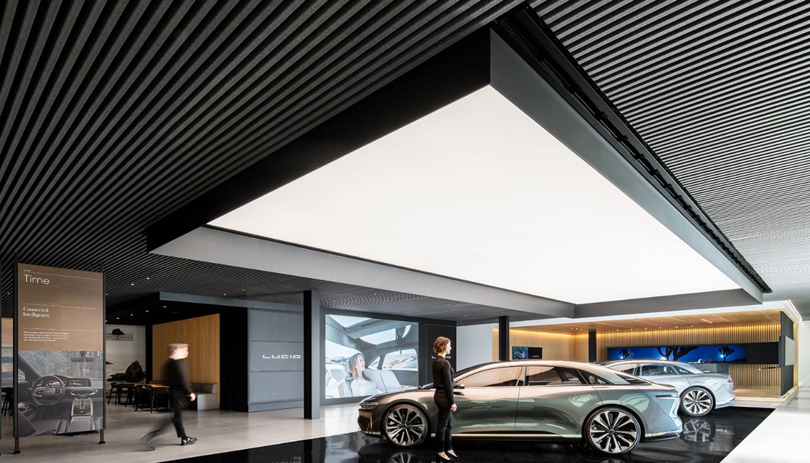
National Accounts

Slide 32
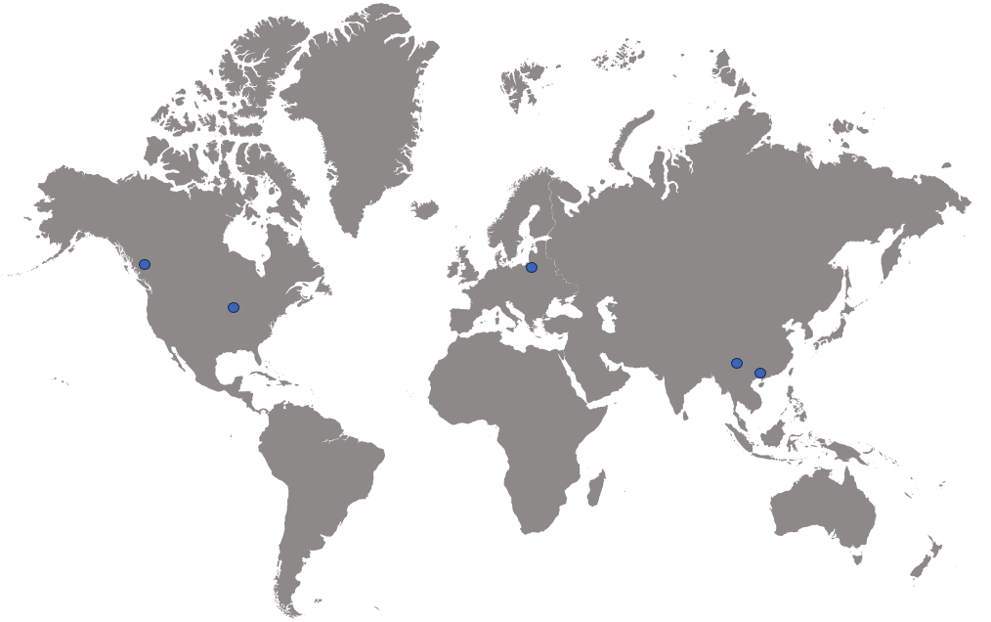
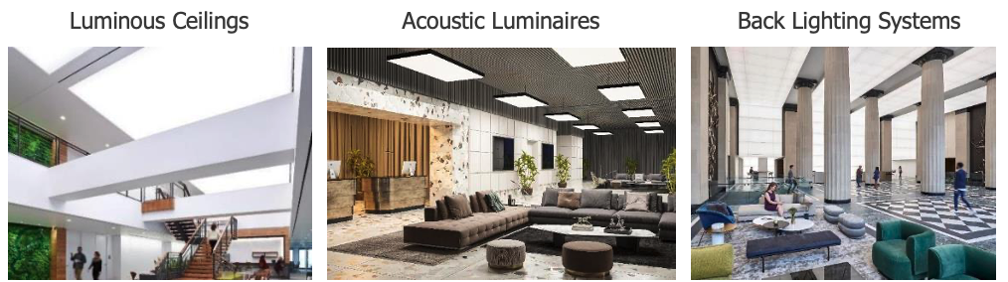






















National Accounts
Cooledge is the global leader in luminous surfaces and backlighting with over 10,000 installations including multiyear rollouts with influential brands and companies.
Broad Product Portfolio
Global Manufacturing / Assembly Sites
Global Sustainability Leader
Trusted Partner of the World’s Top Brands

Slide 33
Cooledge National Account Strategy
Began in 2016, really got rolling in 2018, then post-pandemic
International and North America focus
Approach End Users who are using luminous surfaces in their locations and convince them Cooledge has superior products/solutions and service and pitch the value prop, usually saving them money and consolidating responsibility
Approach End Users who aren’t using luminous surfaces and convince them to use luminous surfaces and the convince them we are the right choice
Cover the influencers. Usually architects, who have a focus on retail/auto.
Rep involvement
  Spec Sales
  Distributor Contractor Sales
  Cooledge happy to share commissions and workout meaningful deals for national specs
  Cooledge usually a large portion, can help lock the spec/package

Slide 34

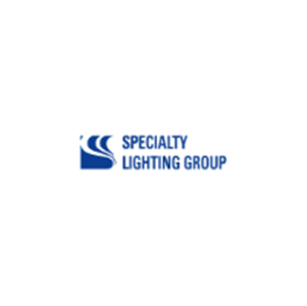


ecosystem
Dealerships/Local Stores
Influencers – Architects, Engineers
NA Distributors & VARs
Contractors
Reps
Notes:
Ways of getting to new OPPY in Key Account environment
Crucial: Being well established and part of the ECO System
LINKEDIN RESEARCH/OUTREACH
Specifier (METIS/B612/ESA)
Architect (CMK/Hyphen)
Brand (YSL to Celine, L’occitane to Givenchy; ESA to YSL)
GC (ESA, SICE PREVIT, PRADA)
IMPORTANCE of Lighting Designers (EXAMPLES/ANEKDOTES) – FOCUS
There are only FEW Specifiers focusing on Key Account/Brands (more research needed) – need to build up in NS
Lighting Designers
METIS (IT) – LV, DIOR, Tiffany, Bulgari, GUCCI
B612 (IT) – Ferragamo, Michael Kors, Bottega Veneta, Maison Margiela
ESA (IT) – LV, YSL
PONCTUELLE (FR) – YSL, Cartier, CHANEL
VoyonsVoir (FR)
Lightbureau (UK)
Lichtvision – AESOP, Jil Sander
Nulty (UK) – NIKE
Roman Schatz (D) - Lamborghini
GSA (US) - CHANEL
Architects
Peter Marino (US) – CHANEL, LVMH
CMK (D, UK) – YSL, CELINE, Jil Sander
Gensler – VW, Lamborghini

Slide 35
Fashion, Cosmetic, Tech - Zack SIMs
NEW! Alaia, Canada Goose, Webster, Oliver Peoples, Casablanca, Thuma
Notes:
NA Distributors, Architects, Lighting Designer, GCs,

Slide 36
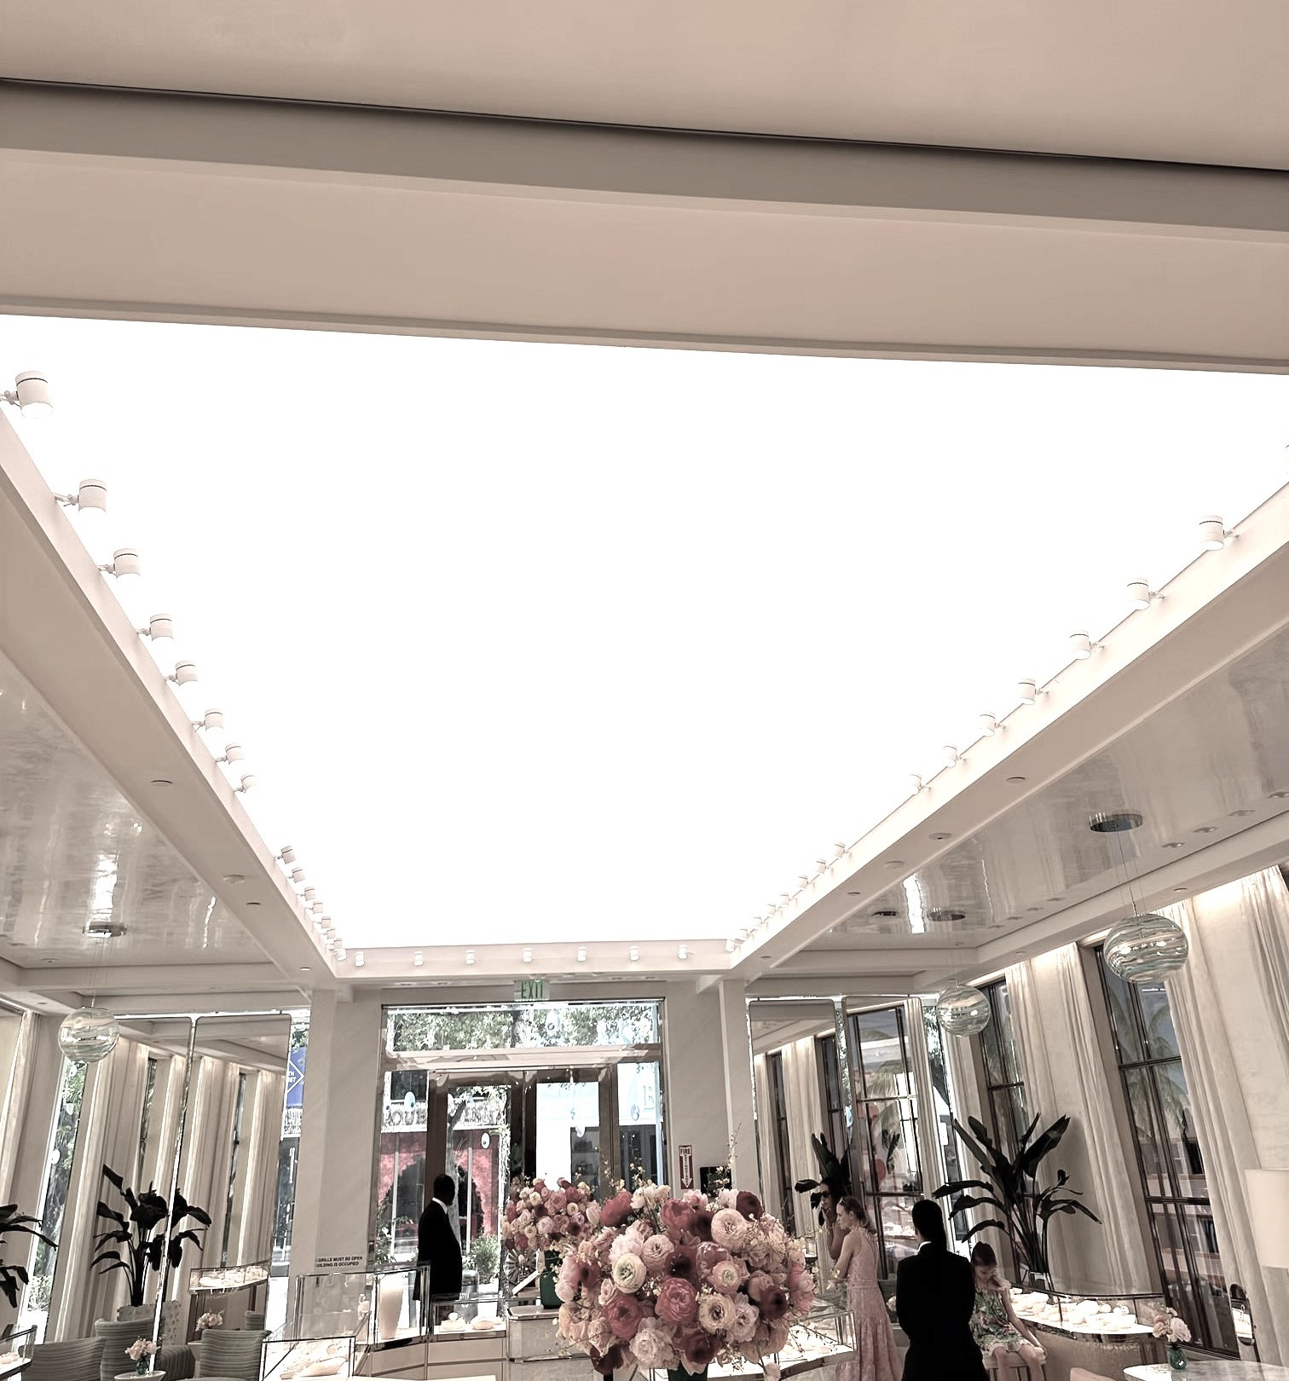
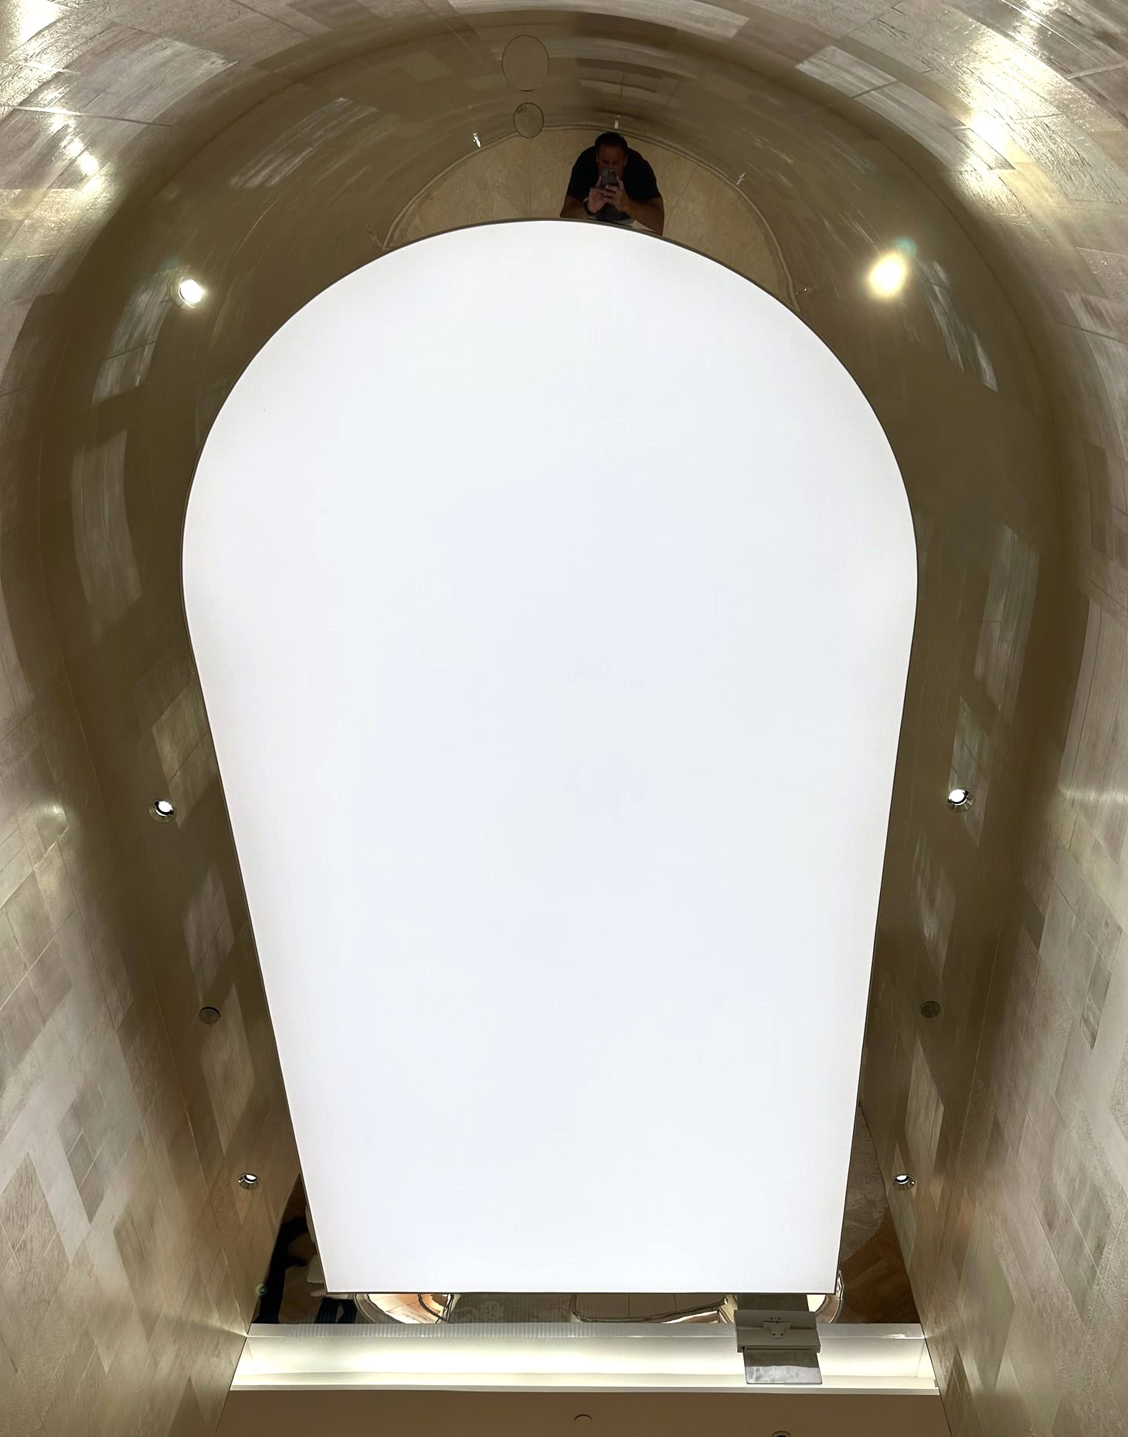

Tiffany & co
Presentation Only – Not for Publication
Notes:
Speaker Notes:
Cooledge SkySpan Flush Mount = HF/4000K
OPPY017214 Tiffany Miami

Slide 37
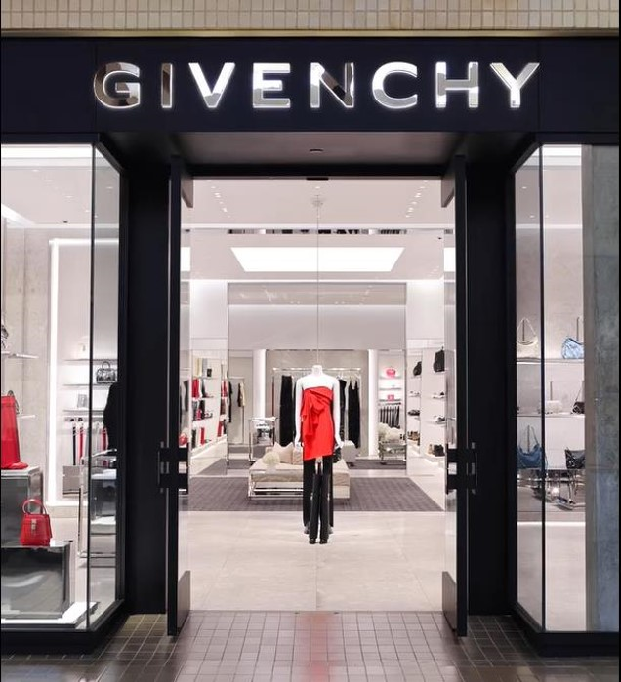
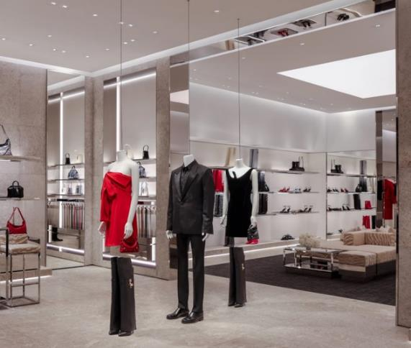
Givenchy north park (dallas, tx)
Presentation Only – Not for Publication
SIZE/AREA
Flush Mount Specialty Illumination Solutions (SIS)
5 Areas of Various Sizes
ARCHITECT
Antonio Maiuolo Architect
Notes:
Speaker Notes:
Cooledge Flush Mount SkySpan – HF/4000K
OPPY017988 Givenchy North Park Dallas

Slide 38
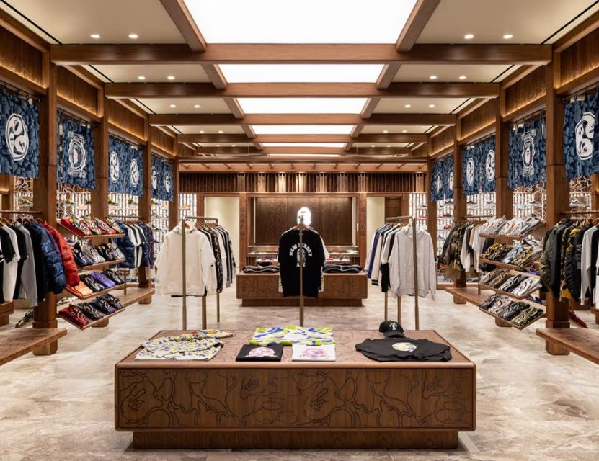
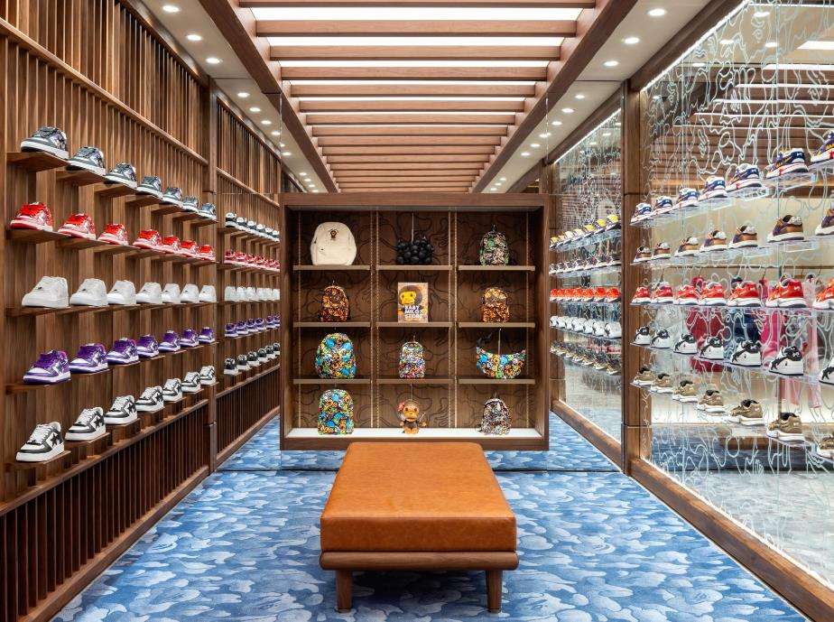
Bape American dream mall (east Rutherford, nj)
Presentation Only – Not for Publication
Architect:
David Pirie – Pirie Group
Consultant/Distributor:
Lido Lighting
SIZE/AREA
6 Specialty Illumination Solutions – Flush Mount
  1 @ 43.9’ x 6.9’ (13.4m x 2.1m)
  3 @ 7.4’ x 7.2’ (2.3m x 2.2m)
  1 @ 7.4’ x 5.4’ (2.3m x 1.6m)
  1 @ 7.3’ x 7.2’ (2.2m x 2.2m)
Notes:
Speaker Notes:
Cooledge SkySpan – Flush Mount (MF/3000K)
OPPY018891 BAPE American Dream Mall

Slide 39
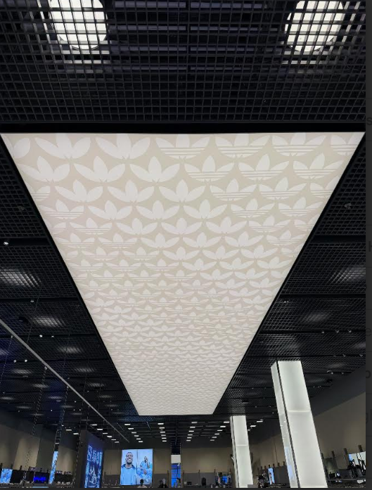
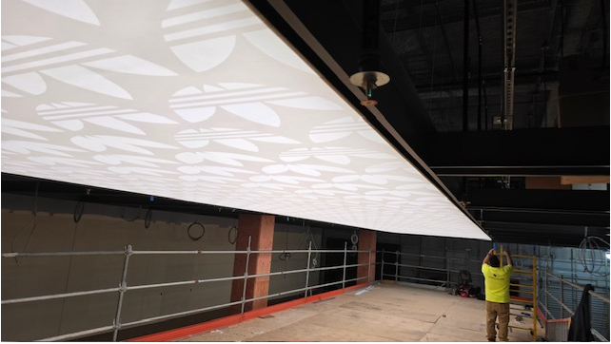
Adidas – Las Vegas
Notes:
SkySpan Suspended 53’ x 11.5’

Slide 40
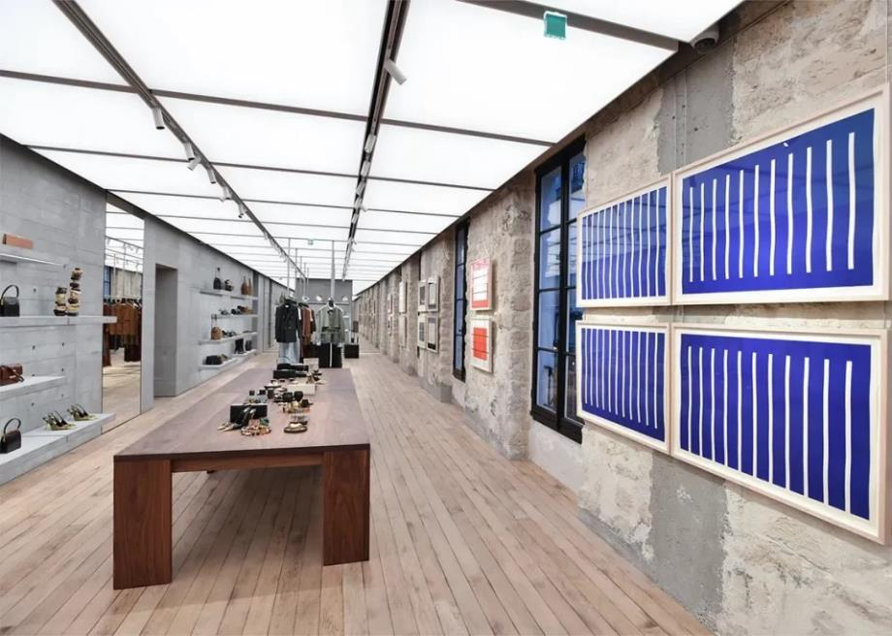

Ysl rive droite (paris, fr)
Presentation Only – Not for Publication
SPECIFIER
ESA Engineering
SIZE/AREA
73 Suspended SIS
2 Surface Mount SIS
Notes:
Speaker Notes:
Cooledge SkySpan – Suspended and Surface Mount (HF/3500K)
OPPY019124 YSL RIVE DROITE

Slide 41

Ysl champs elysee (paris, france)
Presentation Only – Not for Publication
CREATIVE DIRECTOR
Anthony Vaccarello
SPECIFIER
ESA Engineering
SIZE/AREA
Specialty Illumination Solutions – Surface Mount & Suspended
51 Fixtures (23 sizes)
Total Area = 3030 sqft (281 m²)
Notes:
Speaker Notes:
Cooledge SkySpan – Flush Mount (MF/3500K)
OPPY015424 YSL Paris Champs Élysée

Slide 42

YSL meatpacking district (new York)
Presentation Only – Not for Publication
SPECIFIER
ESA Engineering
SIZE/AREA
35 Suspended SIS
3 Surface Mount SIS
Notes:
Speaker Notes:
Cooledge SIS – Mostly Suspended (MF/3500K)
OPPY018587 YSL Meatpacking District NY

Slide 43



Skims galleria (Houston, tx)
Presentation Only – Not for Publication
LIGHTING DESIGN
Sean O’Connor
SIZE/AREA
Luminous Ceiling – Flush Mount
67’ x 54’ (20.4m x 16.5m)
Notes:
Speaker Notes:
Cooledge Flush Mount SkySpan LF/3000K
OPPY018370 Skims Houston SkySpan Materials and Install+ OPPY018655 Skims Houston Lighting

Slide 44

The webster Fontainebleau (las vegas, nv)
Presentation Only – Not for Publication
SIZE/AREA
Luminous Ceiling – Multiple Suspended SkySpan Fixtures
Total Area = 2500sqft (232m²)
Notes:
Speaker Notes:
Cooledge Suspended SkySpan Eco/3000K
OPPY019046 The Webster
Custom shaped suspended SkySpan

Slide 45


Balenciaga American dream mall (east Rutherford, nj)
Presentation Only – Not for Publication
SIZE/AREA
9 SkySpan – Surface Mount
Various Sizes
Notes:
Speaker Notes:
Cooledge SkySpan – MF/TNW
OPPY016899 Balenciaga American Dream Mall
Rustic Subway appearance.

Slide 46



Prada ion orchard (Singapore)
Presentation Only – Not for Publication
SIZE/AREA
Specialty Illumination Solutions – Flush Mount
3 Ovals + 1 Circle
SPECIFIER
Metis Lighting
Notes:
Speaker Notes:
Cooledge SIS – Flush Mount (MF/TNW)
OPPY018477 Prada ION Singapore
Shapes work well with the architecture.

Slide 47

Gucci short hills (short hills, nj)
Presentation Only – Not for Publication
ARCHITECT
Atmosphere Design Group
LIGHTING DESIGN
TM Light
SIZE/AREA
SkySpan – Surface Mount
18.0’ x 12.5’ (5.5m x 3.8m)
Notes:
Speaker Notes:
Cooledge Flush Mount SIS – XHF/3000K
OPPY018825 Gucci Short Hills

Slide 48



Arc’teryx Kitsilano (Vancouver, bc)
Presentation Only – Not for Publication
Quote from Arc’teryx employee:
“I love it. It sorta makes it feel like daylight”
SIZE/AREA
9 FABRILum RXL Luminaires
(6’ x 6’/1.8m x 1.8m)
Notes:
Speaker Notes:
Cooledge FABRILum (SF/3500K)
OPPY015149 Arc'Teryx Vancouver 4th St.
Faux Ceiling effect

Slide 49






Sephora luminous ceiling “runway” feature (multiple locations)
Presentation Only – Not for Publication
Chinook Mall (Calgary)
34th Street (New York)
Century City Mall (Los Angeles)
South Coast Plaza (Costa Mesa, CA)
Powell Street (San Francisco)
Prudential Center (Boston)
Notes:
Speaker Notes:
One common design feature of several renovated Sephora stores is a long stretch ceiling feature (~50’x10’) – “runway” is a Cooledge Marketing reference not the client’s. Where the stretch ceiling is known it seems to be Newmat.

Slide 50












Allbirds rollout
Presentation Only – Not for Publication
Charlotte
Atlanta – Ponce City
New York - Flatiron
Palo Alto – Stanford Center
New York - Columbus
Garden State Plaza
Chicago – Oakbrook Center
Los Angeles – Century City
Boston – Derby Street
Boston – Cambridge
Denver – Cherry Park
Carlsbad
Notes:
Speaker Notes:
FABRICated Luminaire
OPPY012789 Allbirds Stores
Cash Wrap

Slide 51












Rollout programs: Levi Strauss & co.
Presentation Only – Not for Publication
New York – Times Square
9’ x 29’
New York – Hudson Yards
10’ x 19’
Boston – Derby Shops
9’ x 25’ + 9 Luminaires
Portland
10’ x 23’
Dallas – North Park Mall
9’ x 38’ + 5 Luminaires
Vancouver – Park Royal
8’ x 32’ & 8’ x 24’
Tokyo – Harajuku
12 FABRICated Luminaires
Palo Alto – “Next Gen Store”
8’ x 32’ + 2 Luminaires
Seattle – Bellevue Square
10’ x 25’ + 5 Luminaires
Las Vegas – Forum Shops
8’ x 41’ & 6’ x 29’
Miami – Aventura Mall
8’ x 29’ & 6’ x 31’
Birmingham _ Summit
11’ x 25’ + 5 Luminaires
Notes:
Speaker Notes:
Cooledge SkySpan – Surface Mount (HF/3500K)
OPPY008905 Levi Strauss NYC TIMES SQUARE LEVI STRAUSS

Slide 52
Auto, Fitness, Financial, Hospitality – BrIAn rakip
NEW: Chevrolet, Buick, MINI
Notes:
Influencers – Brand, Architect NA Distributor, International, LDs

Slide 53

Caddy

Slide 54




Cadillac
Presentation Only – Not for Publication
Completed: 61 locs
Backlog: 32 locs
Notes:
Speaker Notes:
Cooledge SkySpan Flush Mount – MF/4000K
OPPY011832 Libertyville Cadillac
Typical - 12’ x 72 or 12’x48

Slide 55


Napleton Cadillac (Libertyville, il)
Presentation Only – Not for Publication
ARCHITECT
Gensler
SIZE/AREA
2 luminous areas: 72’ x 12’ (21.9m x 3.6m)
2 luminous areas: 23’ x 12’ (6.9m x 3.6m)
2280 sqft (212 m²)
Notes:
Speaker Notes:
Cooledge SIS Flush Mount – MF/4000K
OPPY011832 Libertyville Cadillac
1st Cadillac KSA

Slide 56


suburban Cadillac (Plymouth, mI)
Presentation Only – Not for Publication
ARCHITECT
Gensler
SIZE/AREA
2 luminous areas: 20’ x 8’ (6.1m x 2.4m)
1 luminous area: 88’ x 12’ (26.8m x 3.6m)
1 luminous area: 112’ x 12’ (34.1m x 3.6m)
Total = 2720 sqft (253 m²)
Notes:
Speaker Notes:
Cooledge SIS Flush Mount – MF/4000K
OPPY013206 Suburban Cadillac of Plymouth

Slide 57



Tom peacock Cadillac (Houston, tx)
Presentation Only – Not for Publication
ARCHITECT
Gensler
SIZE/AREA
2 luminous areas: 24’ x 12’ (7.3m x 3.6m)
2 luminous areas: 48’ x 12’ (14.6m x 3.6m)
2 luminous areas: 96’ x 12’ (29.2m x 3.6m)
Total = 4032 sqft (375 m²)
Notes:
Speaker Notes:
Cooledge SIS Flush Mount – MF/4000K
OPPY016658 Tom Peacock Cadillac

Slide 58





Basis of Design – design intent drawings

Slide 59


Cadillac

Slide 60




GENERAL MOTORS
Notes:
1900 Buick GMC
2900 Chevy

Slide 61

BUICK GMC Render

Slide 62

BUICK GMC RENDER

Slide 63







Buick gmc did
Notes:
1900 Locations Nationally

Slide 64

BUICK/GMC design

Slide 65



Chevy did
Notes:
2900 Locations Nationally

Slide 66

Chevrolet Design

Slide 67



Porsche
Presentation Only – Not for Publication
Installed: 65 locs
Backlog: 14 locs
Notes:
Speaker Notes:
Cooledge SIS Flush Mount – HF/4000K
OPPY014197 Bergstrom Porsche (Appleton WI)

Slide 68

Porsche north Detroit (Detroit, Mi)
Presentation Only – Not for Publication
ARCHITECT
Vocon
SIZE/AREA
Flush Mount Specialty Illumination Solution
17.5’ x 12’ (5.3m x 4.1m)
Notes:
Speaker Notes:
Cooledge SIS Flush Mount (HF/4000K)
OPPY015141 Porsche Detroit North

Slide 69




Lexus (Temecula, ca)
Presentation Only – Not for Publication
ARCHITECT
Whitfield Associates
SIZE/AREA
Flush Mount SIS
13.2' X 57.5’ (4.0m x 17.5m) Trapezoid
Notes:
Speaker Notes:
Cooledge SIS – Flush Mount (HF/4000K)
OPPY012106 Temecula Valley Lexus

Slide 70



Ferrari showroom (calgary, ab)
ARCHITECT
T.i. Studios
LIGHTING DESIGN
Optics Lighting
PROJECT MANAGEMENT
Thinc-design
CLIENT
Ferrari Maserat of Alberta
SIZE/AREA
1000 sqft (93 m²)
>> 8 Flush Mount SIS 17’x7’ (5.25m x 2.20m)
Notes:
Speaker Notes:
Cooledge SIS – Flush Mount (HF/3500K)
OPPY004857 Ferrari Maserati Showroom - Calgary, AB

Slide 71

Mag Ferrari showroom – tunable white (Dublin, oh)
ARCHITECT
Archall Architects, LLC
SIZE/AREA
430 sqft (93 m²)
4 Flush Mount SIS
3 @ 17’x7’ (5.25m x 2.20m)
1 @ 15.5’ dia (4.7m dia)
Notes:
Speaker Notes:
Cooledge SIS – Flush Mount (HF/TNW)
OPPY012131 MAG Ferrari

Slide 72

Aston martin (dallas, tx)
Presentation Only – Not for Publication
LIGHTING DESIGN
Scott Oldner Lighting Design
CLIENT
Aston Martin
SIZE/AREA
Flush Mount SIS (Tunable White: 24’ X 12’ (7.3m x 3.7m)
Notes:
Speaker Notes:
Cooledge SIS – Flush Mount (HF/TNW)
OPPY014259 Aston Martin Avondale

Slide 73


Audi Omaha – vehicle handover (omaha, ne)
ARCHITECT
Carlson West Povondra Architects
LIGHTING DESIGN
Morrissey Engineering
SIZE/AREA
2 @ 21’ x 12’ (6.4m x 3.7m)
504 sqft (47 m²)
Notes:
Speaker Notes:
Cooledge SIS – Surface Mount (HF/4000K)
OPPY007258 Baxter Audi - Omaha NE (hybrid)

Slide 74



Keyes honda (van nuys, ca)
Presentation Only – Not for Publication
Custom “Faux Wood” Finish
ARCHITECT
Dennis Flynn Architects
SIZE/AREA
Specialty Illumination Solution (“SIS”) - Suspended
4 @ 10’ dia (3.0m dia)
10 @ 6’ dia (1.8m dia)
Notes:
Speaker Notes:
Cooledge SIS Suspended (XHF/4000K)
OPPY014752 Keyes Honda Dennis Flynn Architects

Slide 75



Bank of America (palm springs, ca)
Presentation Only – Not for Publication
ARCHITECT
Gensler
SIZE/AREA
Luminous Ceiling – Flush Mount
11 @ 82” dia (2.1m dia)
+
Supplemental Lighting
(Exterior/Interior)
Notes:
Speaker Notes:
Cooledge Flush Mount SIS HF/3500K
OPPY013919 Bank of America Palm Springs

Slide 76


La fitness – braun rd (san Antonio, tx)
Presentation Only – Not for Publication
SIZE/AREA
FABRILum Rectangles
8 @ RL (4’x8’/1.2mx2.4m)
Notes:
Speaker Notes:
Cooledge FABRILums SF/3500K
OPPY018528 LA Fitness San Antonio Braun

Slide 77
LeT’s work together
Strategy session on local national brands and/or influencers
Joint calls
AIA presentations
Cooledge is happy to pay appropriately proportional to the work being done
Jason Rakip – Jason.Rakip@cooledgelighting.com 617.620.6177
Zack Sims – Zachary.sims@cooledgelighting.com
Brian Rakip – Brian.Rakip@cooledgelighting.com

