Slide 1
Introduction to skyline
September 2025

Slide 2
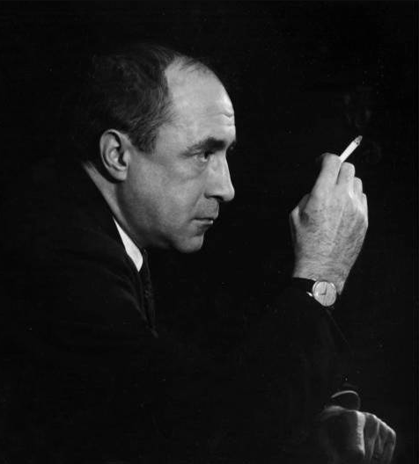
The elements of light
“Three elemental kinds of light effect”*
Focal Glow
Play of Brilliants
Ambient Luminescence
Cooledge Luminous Ceilings = Ambient Luminescence
The comfortable background lighting of life
In its ideal form provides “shadowless illumination”
Suggests the “freedom of space” in the same way nature’s luminous surface, the sky, provides
  “the uninterrupted light of a snowy morning in the open country."
*Presented at a lecture titled “Lighting as an Integral Part of Architecture” (sorta sounds like using “light as a building material”)
Richard Kelly
Notes:
Speaker Notes:

Slide 3
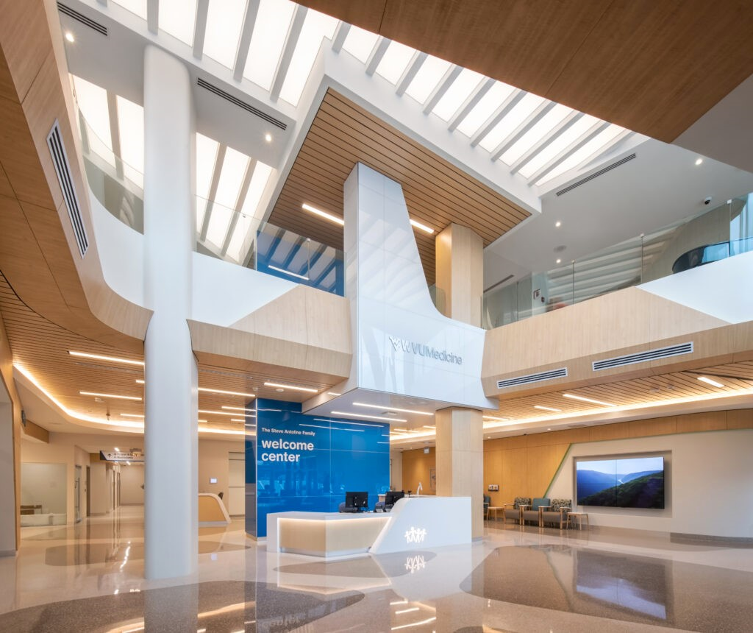
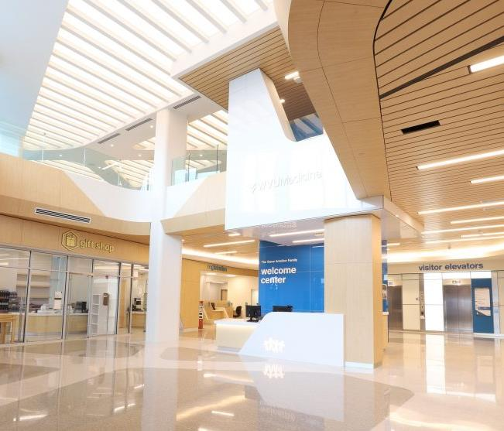
Wvu medicine children’s hospital (Morgantown, wV)
Presentation Only – Not for Publication
ARCHITECT
IKM Architecture
LIGHTING DESIGN
Lam Partners
SIZE/AREA
Flush Mount Specialty Illumination Solutions
  Approx. 1000 sqft (93m²)
Notes:
Speaker Notes:
Flush Mount SIS – MF/3000K
OPPY010366 WVUM WOMENS AND CHILDRENS

Slide 4
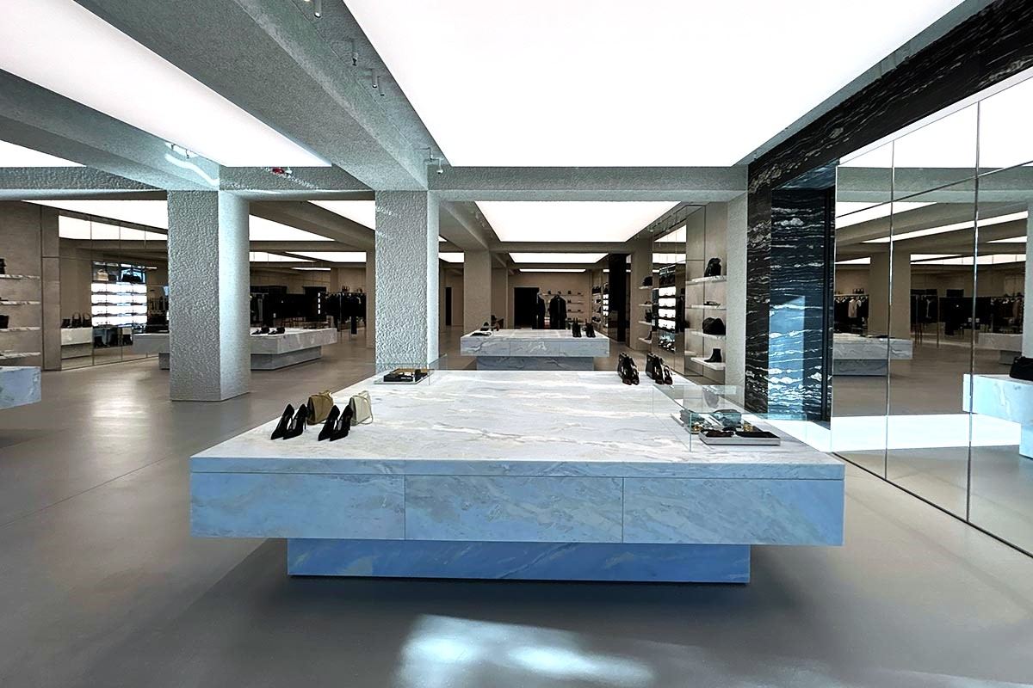
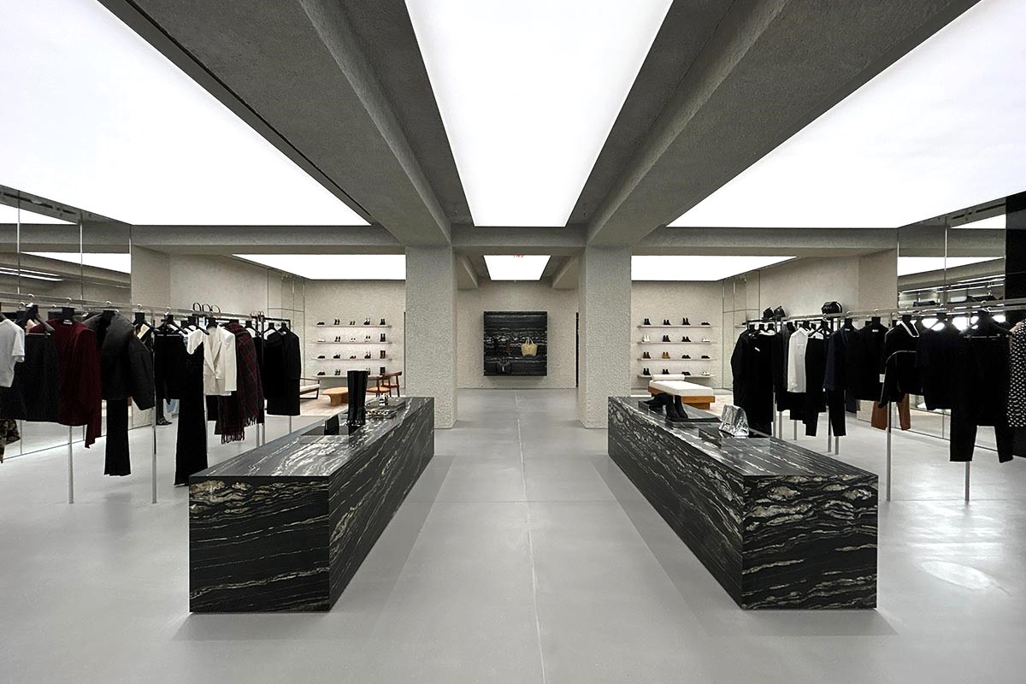
Ysl oakbrook center (Chicago, il)
Presentation Only – Not for Publication
ARCHITECT
Atmosphere Design Group
SIZE/AREA
Specialty Illumination Solutions – Surface Mount
2 @ 14.6’ x 12.8’ (4.5m x 3.9m)
2 @ 19.0’ x 12.8’ (5.8m x 3.9m)
2 @ 20.0’ x 12.8’ (6.1m x 3.9m)
2 @ 17.8’ x 12.8’ (5.4m x 3.9m)
1 @ 14.6’ x 4.9’ (4.5m x 1.5m)
1 @ 19.0’ x 4.9’ (5.8m x 1.5m)
1 @ 20.0’ x 4.9 (6.1m x 1.5m)
1 @ 17.8’ x 4.9’ (5.4m x 1.5m)
Notes:
Speaker Notes:
Cooledge SIS – Surface Mount (MF/3500K)
OPPY015568 YSL Oakbrook Center

Slide 5
The elements of light: what about the others?
“Three elemental kinds of light effect”
Focal Glow
Play of Brilliants
Ambient Luminescence
Directional (Accent) Lighting = Focal Glow
“Focal glow is the follow spot on the modern stage… draws attention, pulls together diverse parts, sells merchandise, separates the important from the unimportant, helps people see.”
Dynamic Lighting = Play of Brilliants
“Play of brilliants excites the optic nerves, and in turn stimulates the body and spirit....”
In our world this concept is now possible using dynamic lighting that can be tunable or incorporate color AND it also speaks to the ability to create lighting that is designed for well-being
Richard Kelly
Notes:
Speaker Notes:

Slide 6
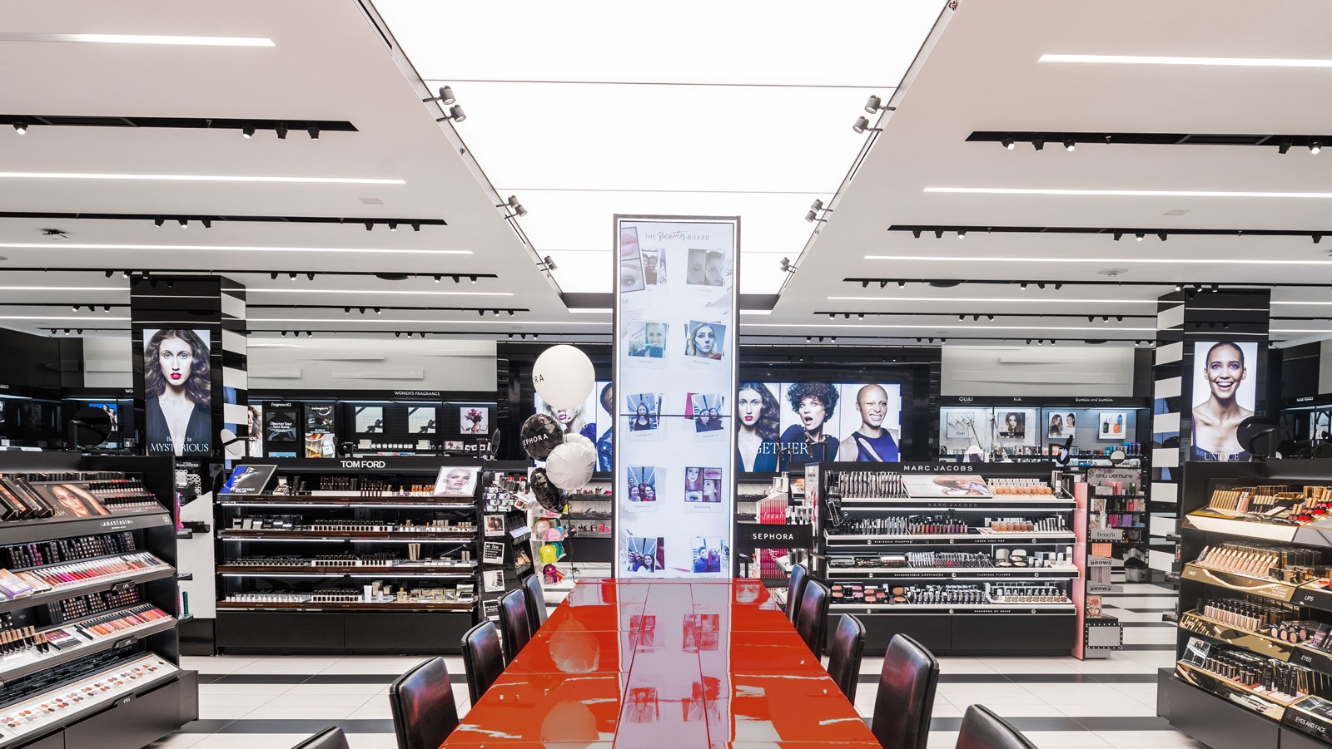
How Elemental Layers of Light are Created Today

Slide 7
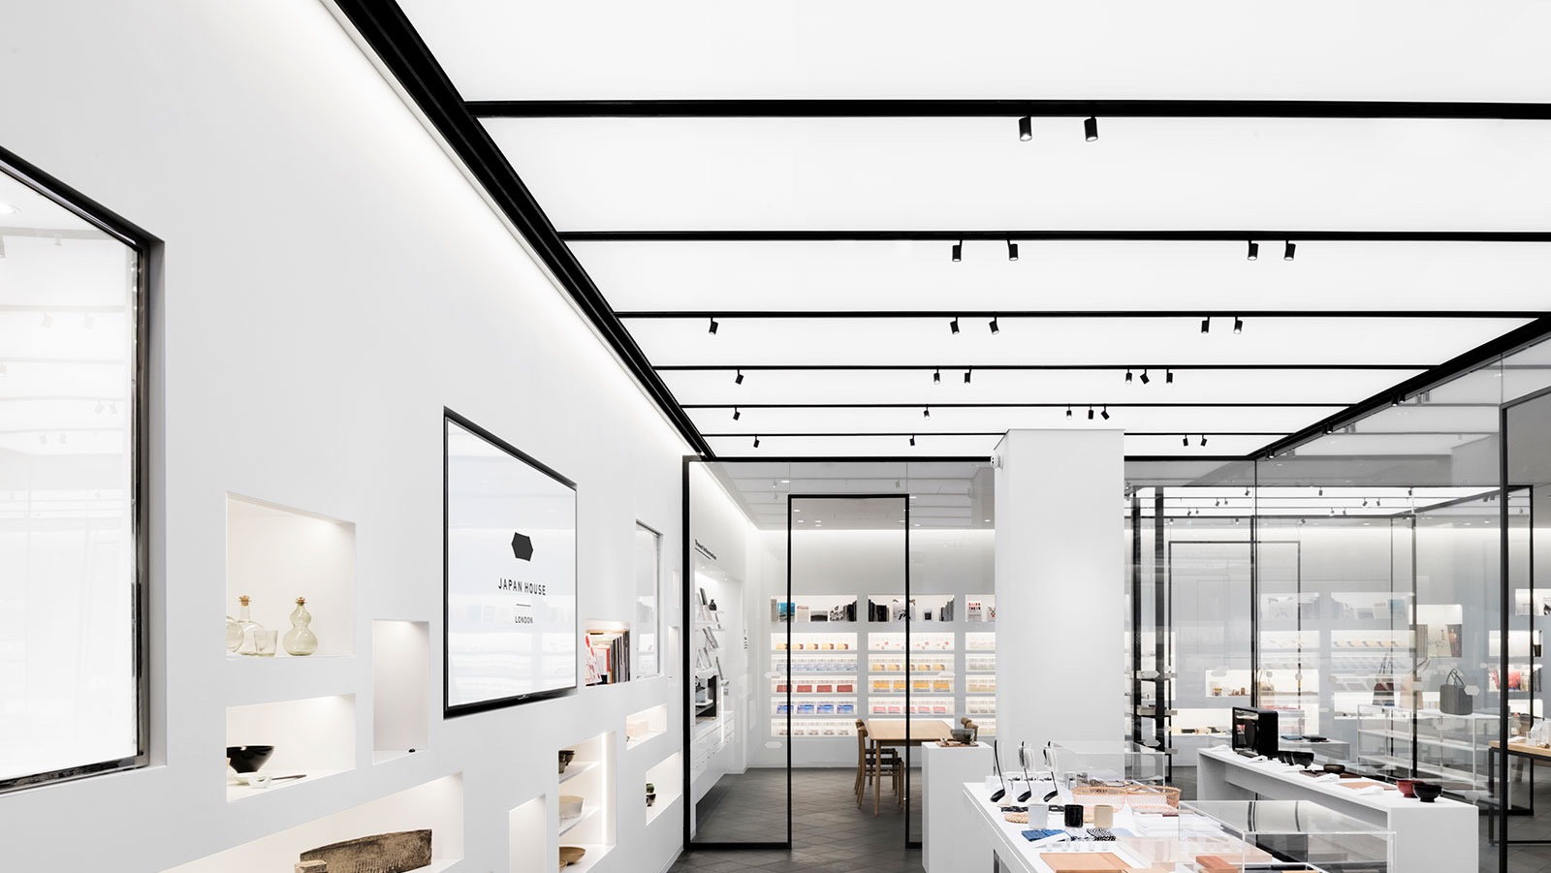
How Elemental Layers of Light are Created Today

Slide 8
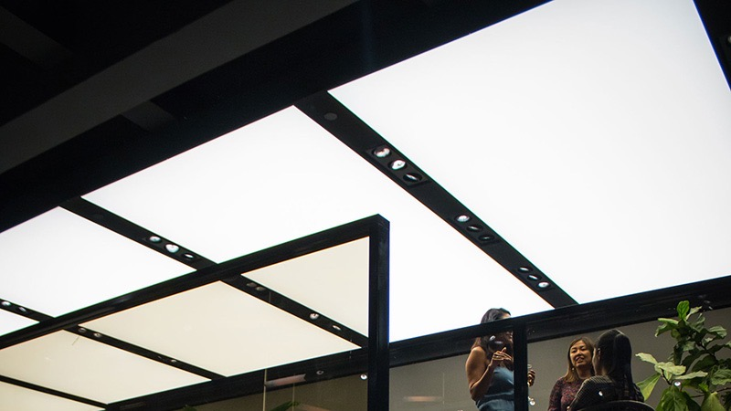
How Elemental Layers of Light are Created Today

Slide 9
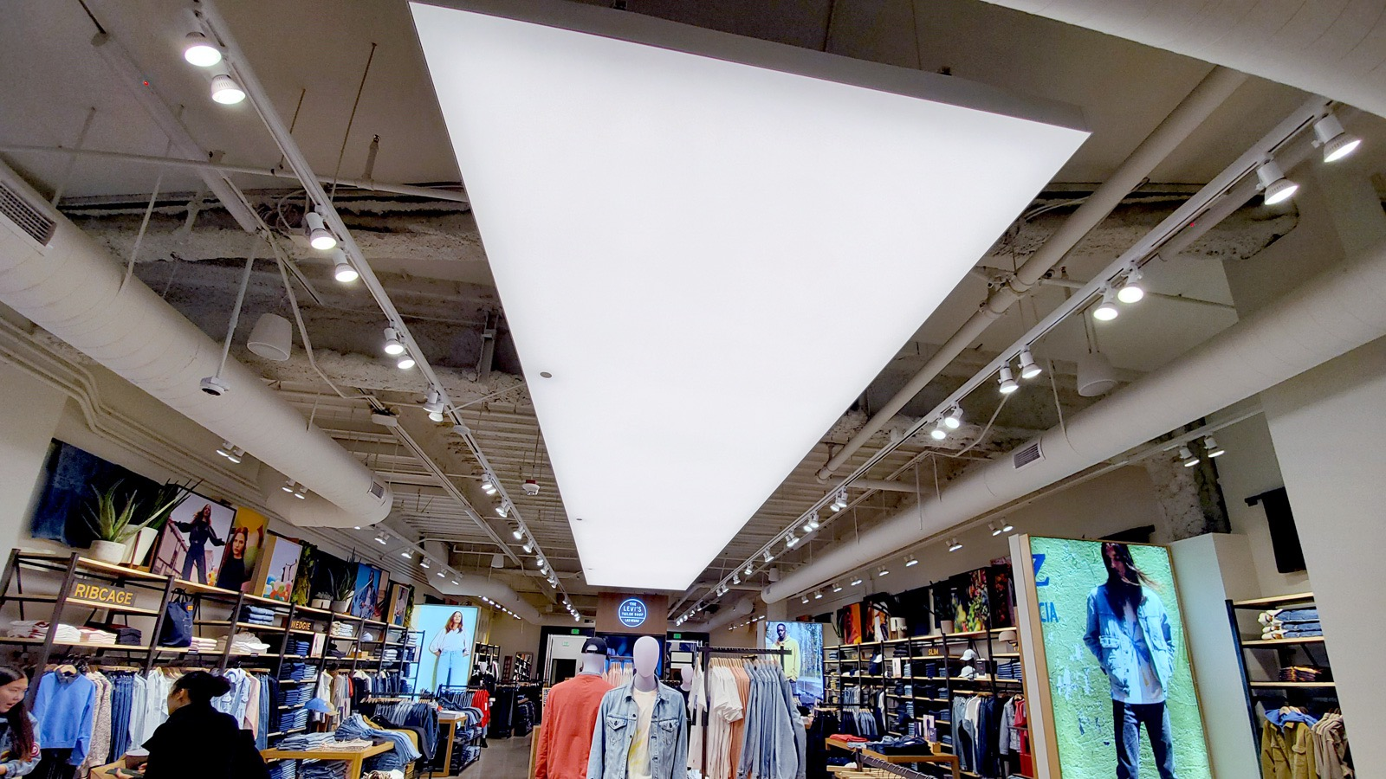
How Elemental Layers of Light are Created Today

Slide 10
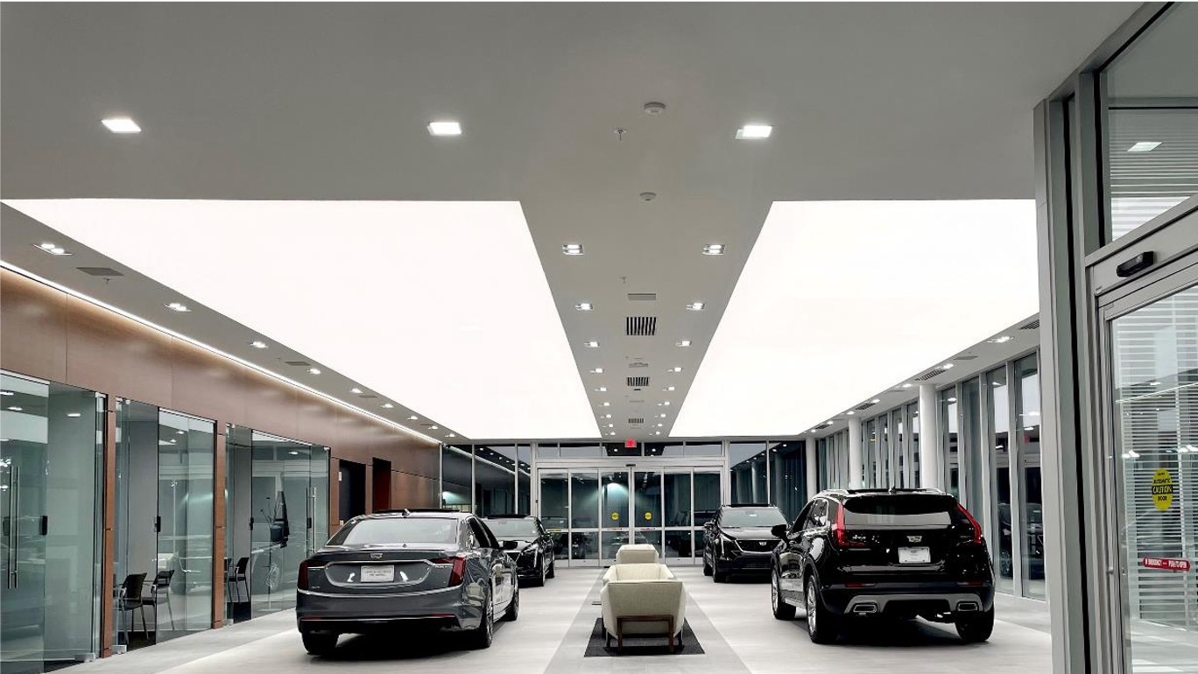
How Elemental Layers of Light are Created Today

Slide 11
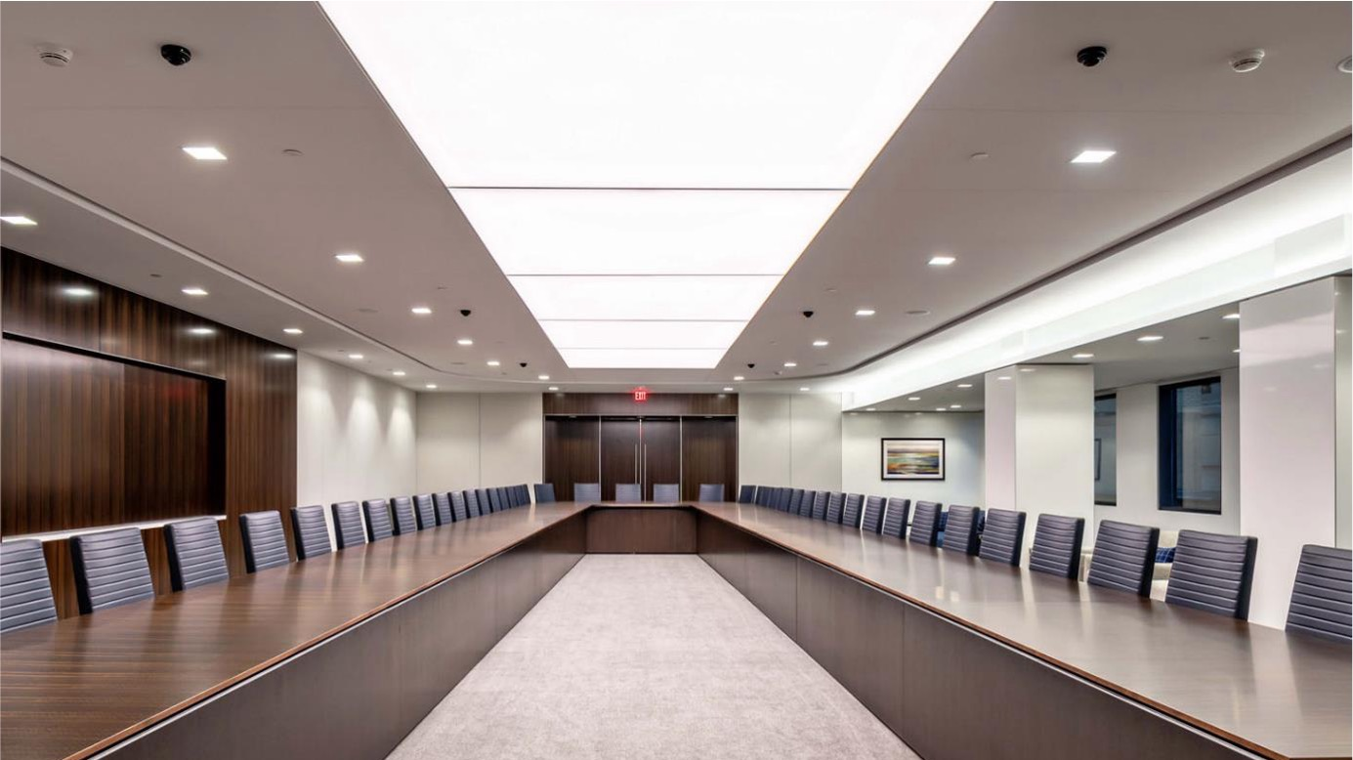
How Elemental Layers of Light are Created Today

Slide 12
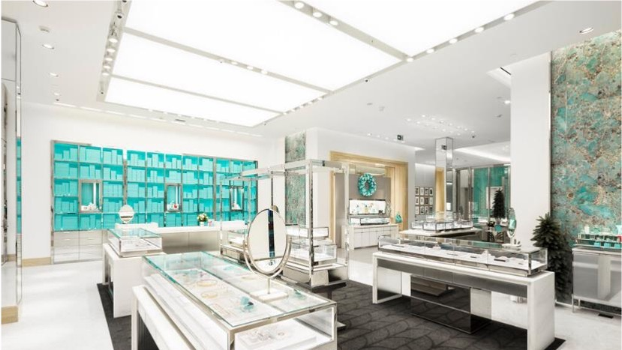
How Elemental Layers of Light are Created Today

Slide 13
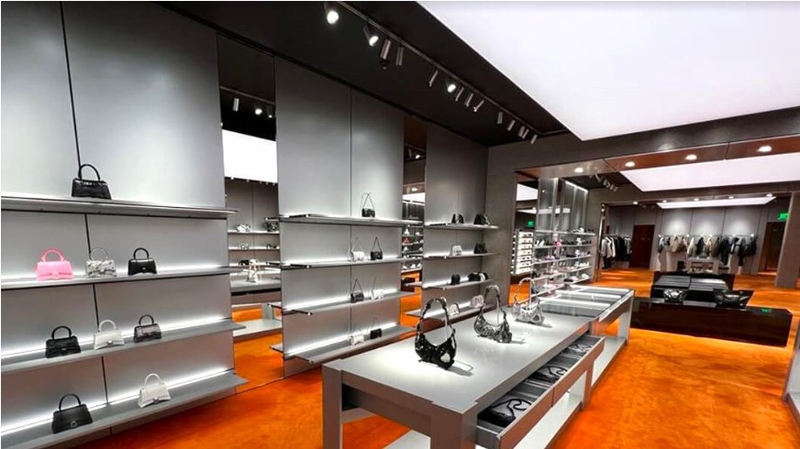
How Elemental Layers of Light are Created Today

Slide 14
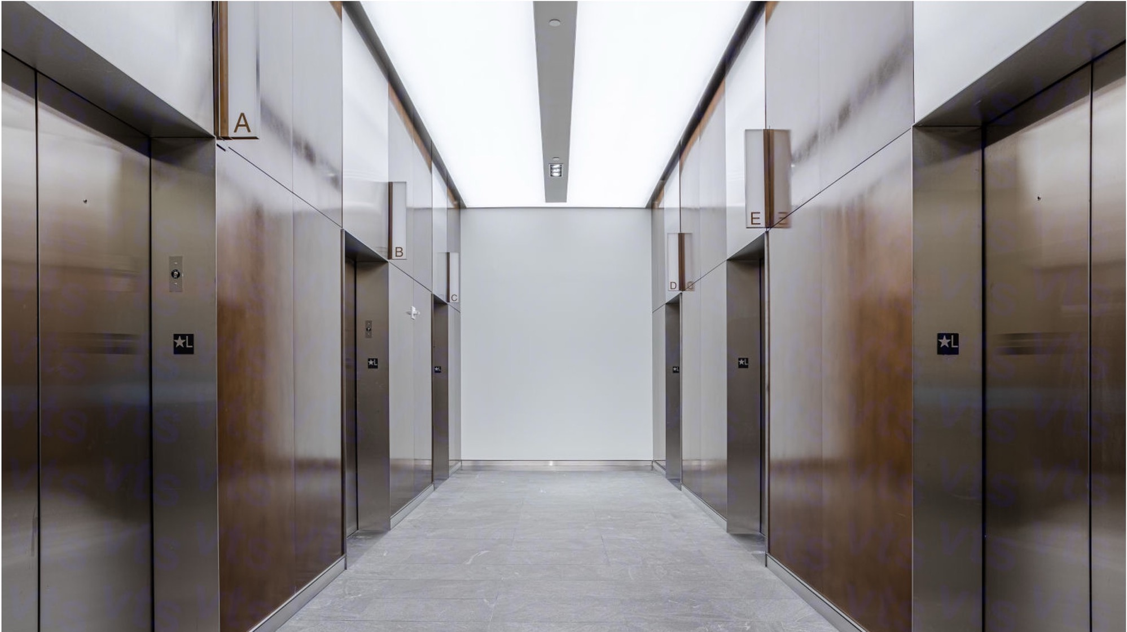
How Elemental Layers of Light are Created Today

Slide 15
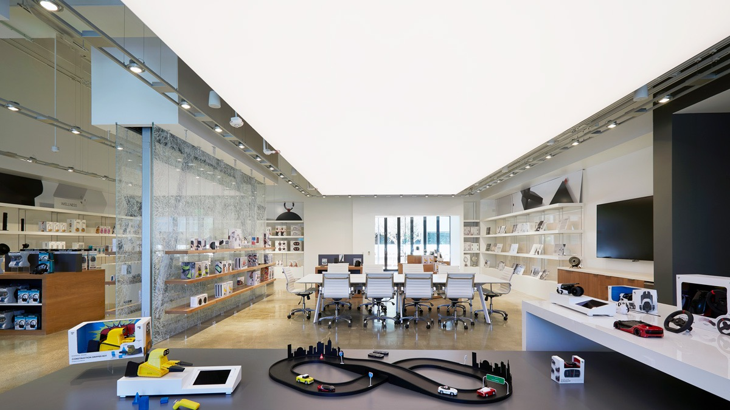
How Elemental Layers of Light are Created Today

Slide 16
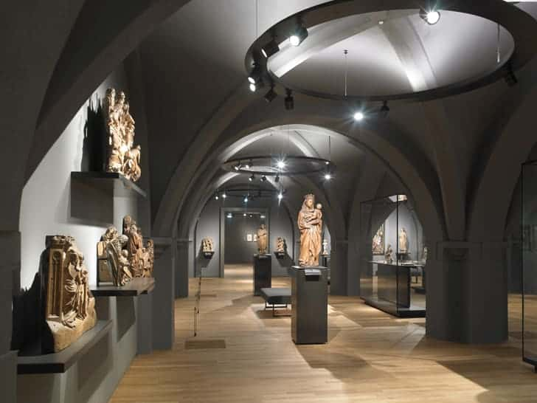
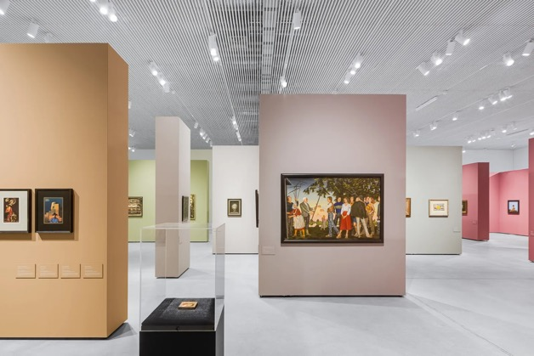
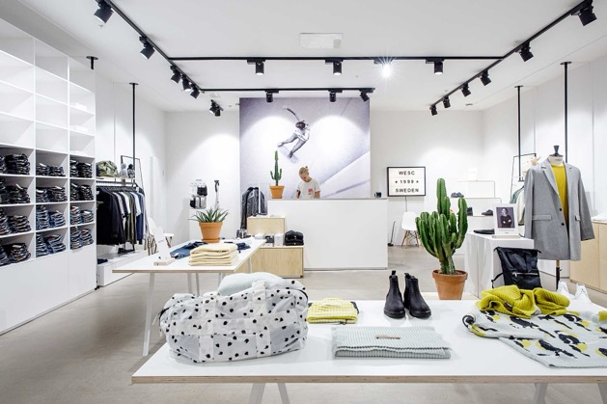
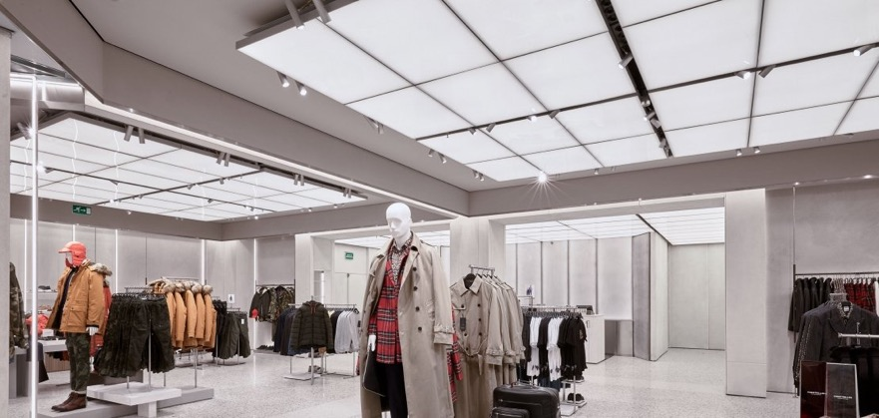
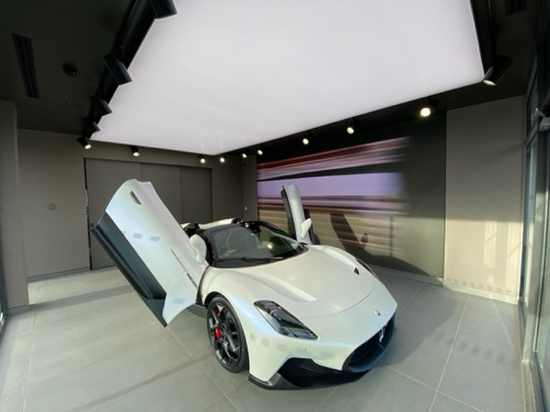
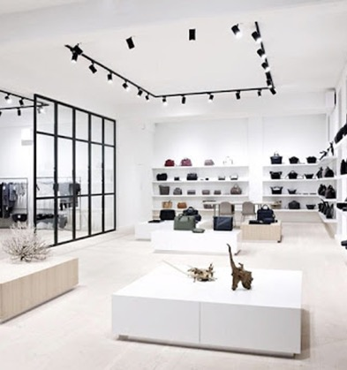
ALL THAT GLARE AND CLUTTER …

Slide 17

Introduces
SkyLine
Notes:
Speaker Notes:

Slide 18
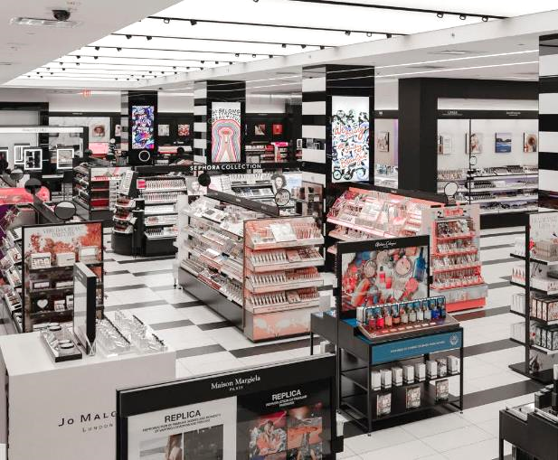
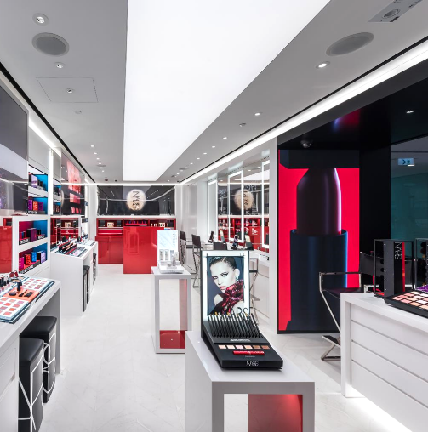
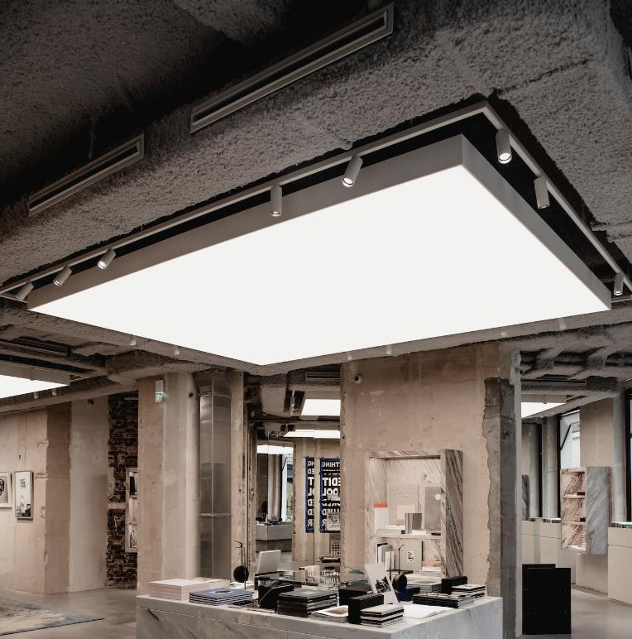
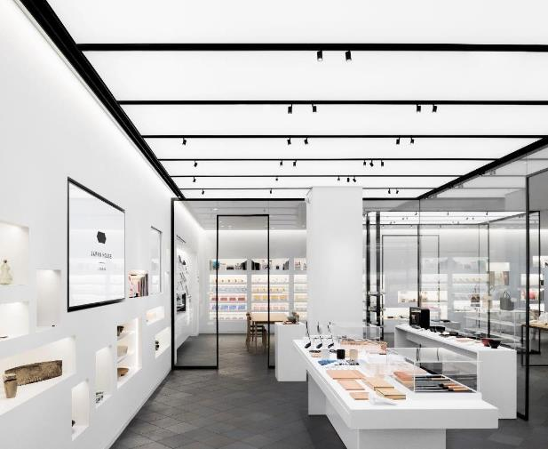
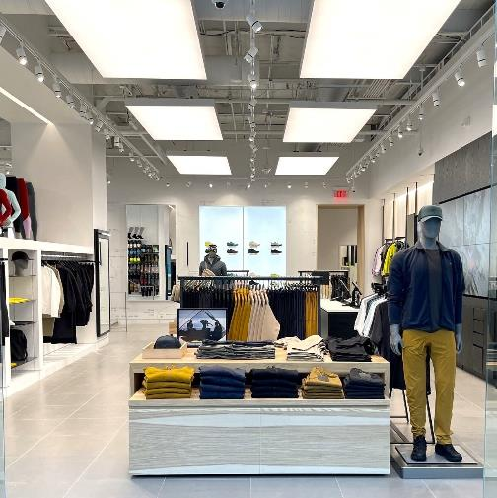
recap: The way it’s done now
Each elemental layer is a separate system that requires additional design and coordination
Notes:
Speaker Notes:

Slide 19
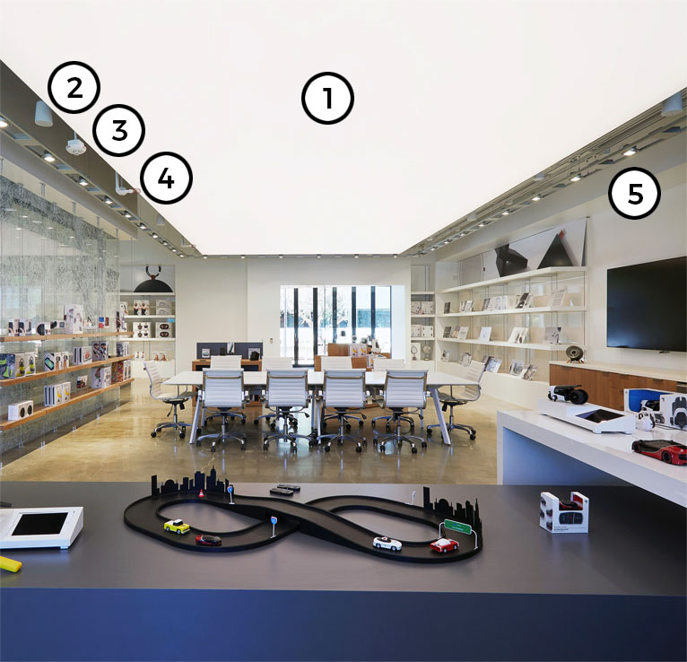
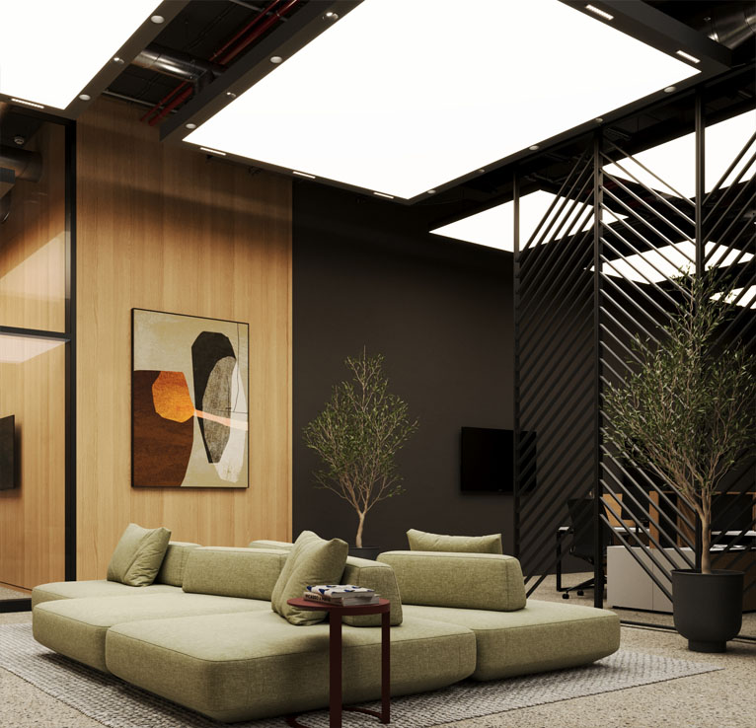
One system: infinite possibilities
Speaker
Smoke Detector
Luminous Ceiling
Sprinkler
Directional Lighting
ONE System
Notes:
Speaker Notes:

Slide 20
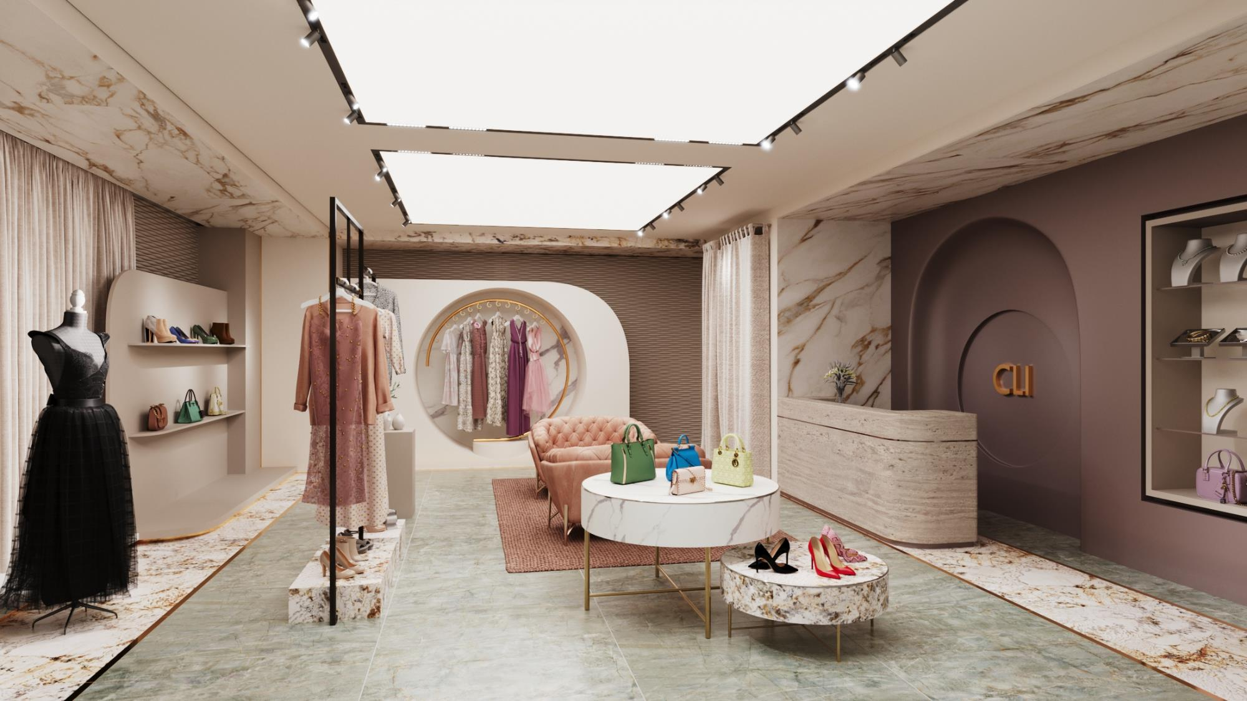
Feature 1: any effect – one system
The New Way
Easier
Faster
SkyLine
Better
Every elemental layer is included in ONE system
Notes:
Speaker Notes:

Slide 21
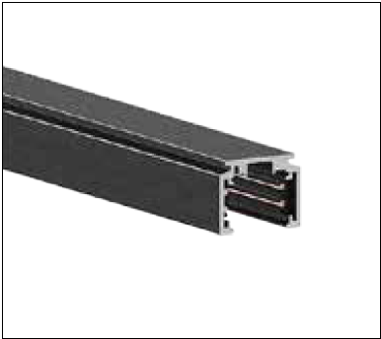
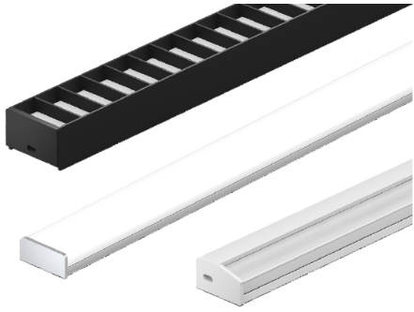
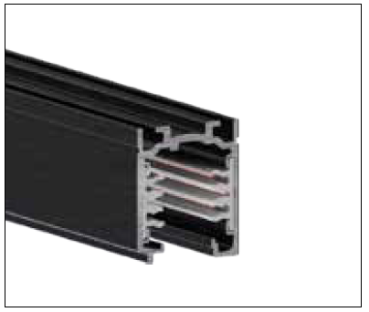
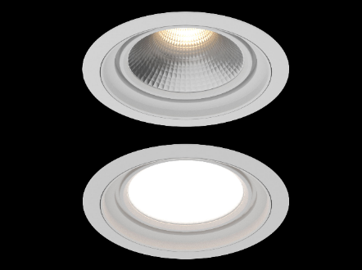
it’s universal
Low Voltage Track
Enables smaller scale track luminaires
Uplights
Addresses the “cave effect”
Integrate Any or All of These into Your SkyLine system
Line Voltage Track
Enables a large selection of most popular track luminaires
Downlights
Enables most common type of accent lighting
Notes:
Speaker Notes:

Slide 22
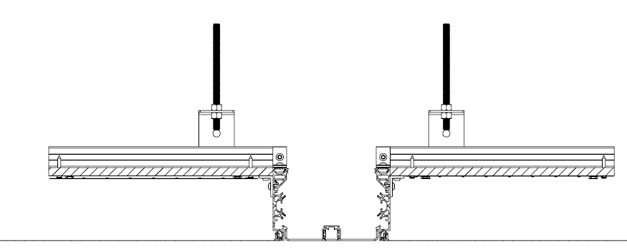
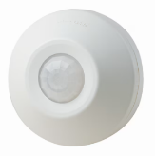
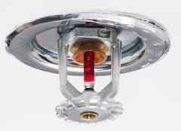
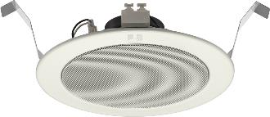
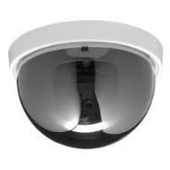
And it’s not just lighting
OTC-W also acts as a “service channel”
Security Cameras
Sensors
Sprinklers
Speakers
Notes:
Speaker Notes:

Slide 23
3 Ways to Achieve Immersive Illumination
Notes:
Speaker Notes:

Slide 24
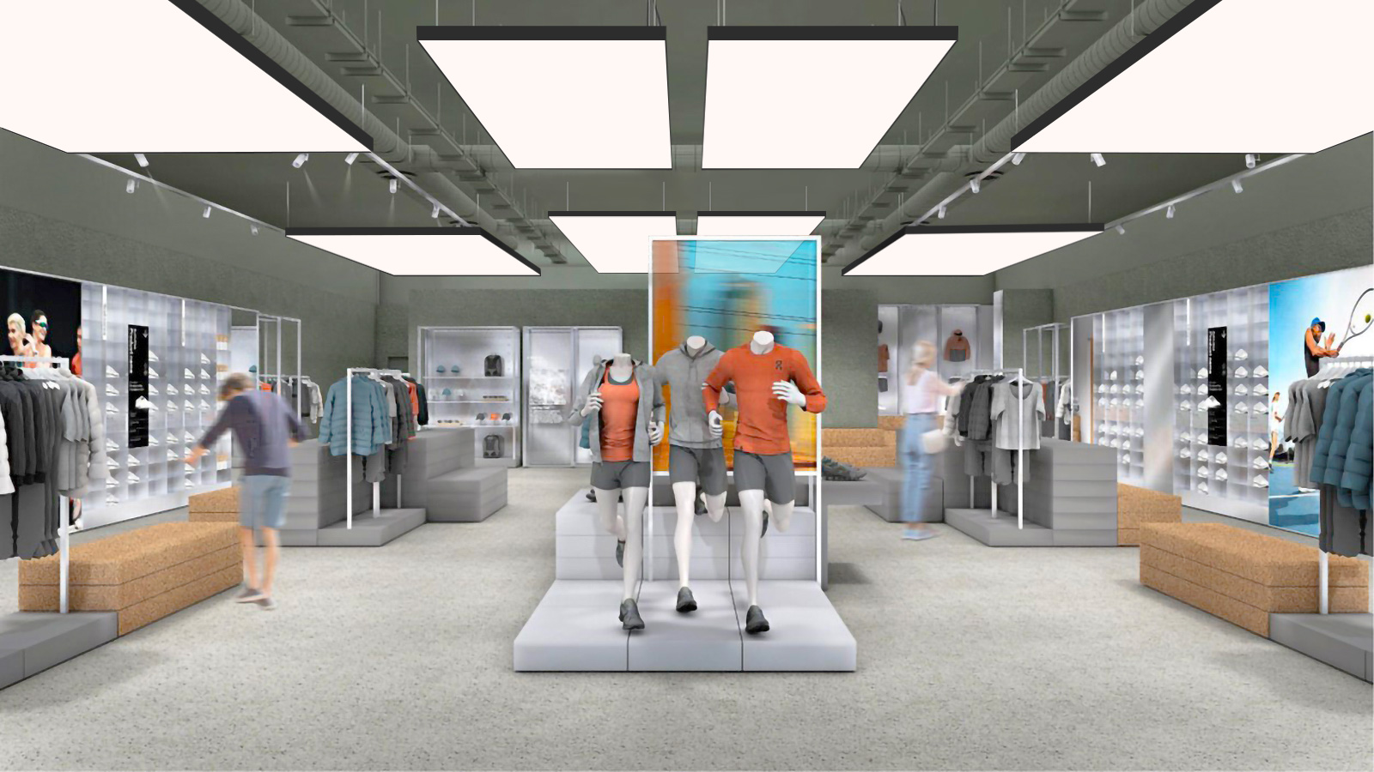
Cooledge FABRILum
Notes:
Speaker Notes:

Slide 25
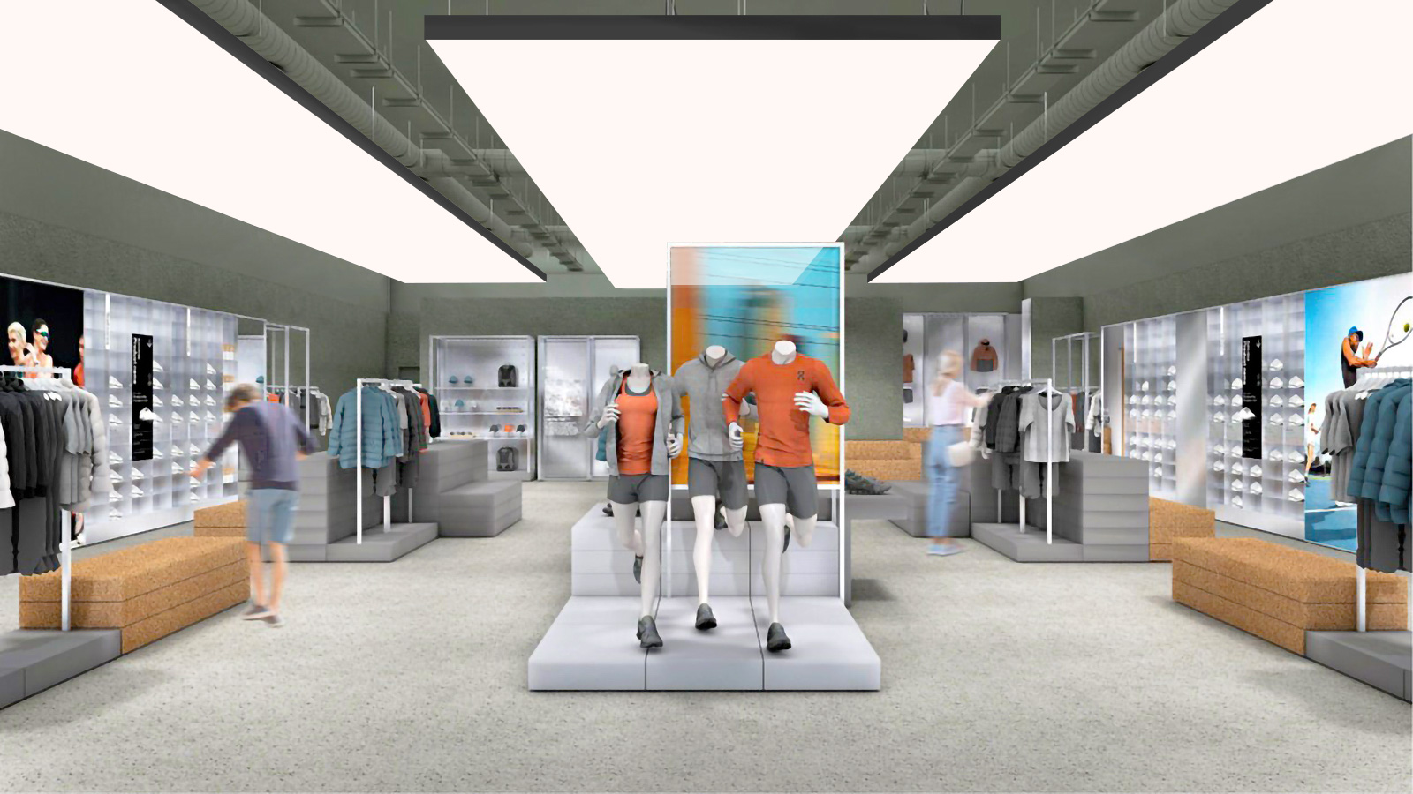
Cooledge SkySpan
(formerly Specialty Illumination Solutions)
Notes:
Speaker Notes:

Slide 26
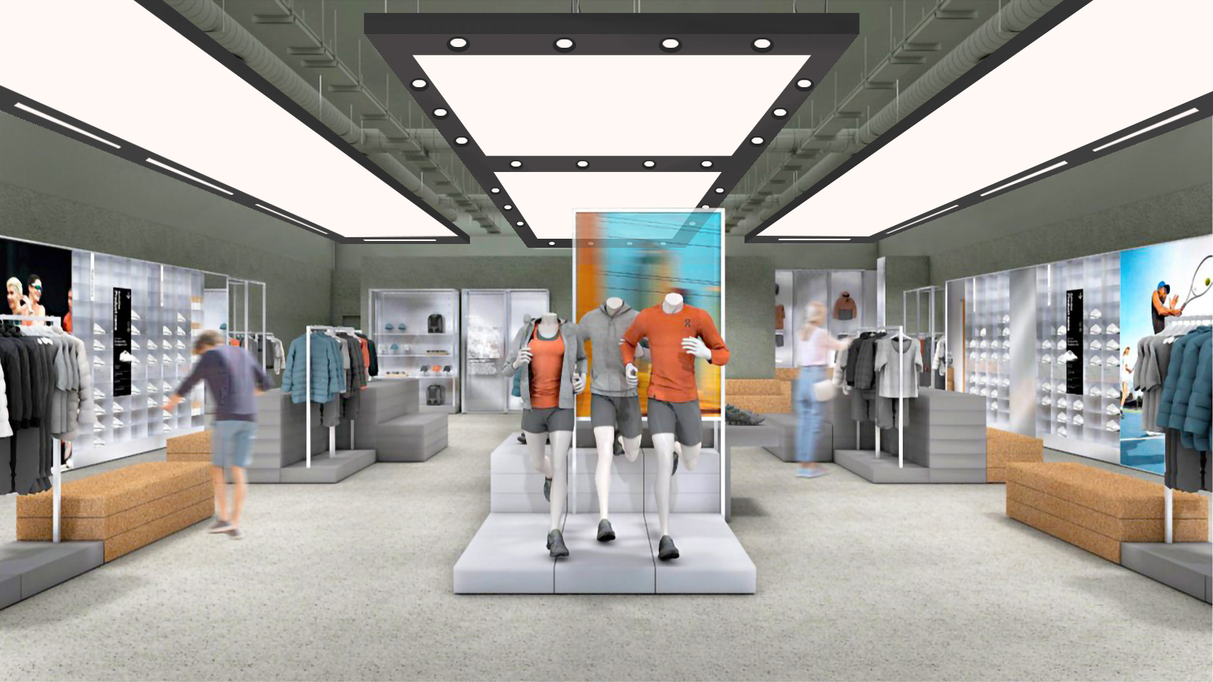
Cooledge SkyLine
Notes:
Speaker Notes:

Slide 27
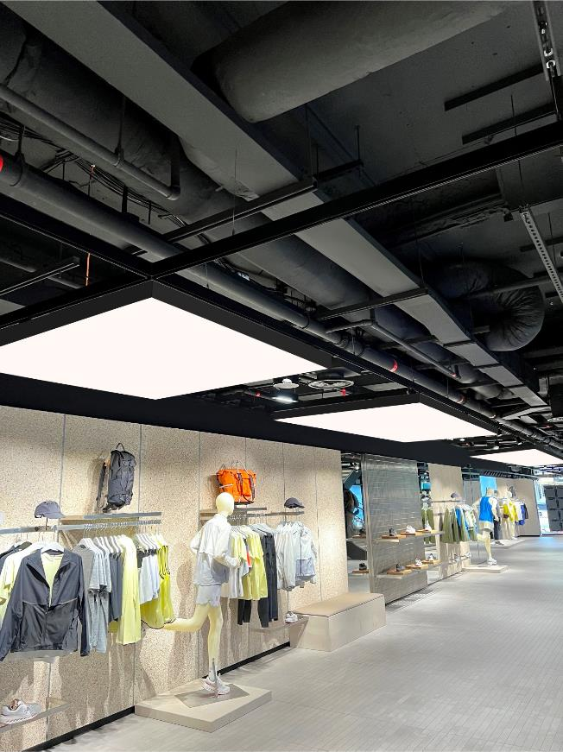
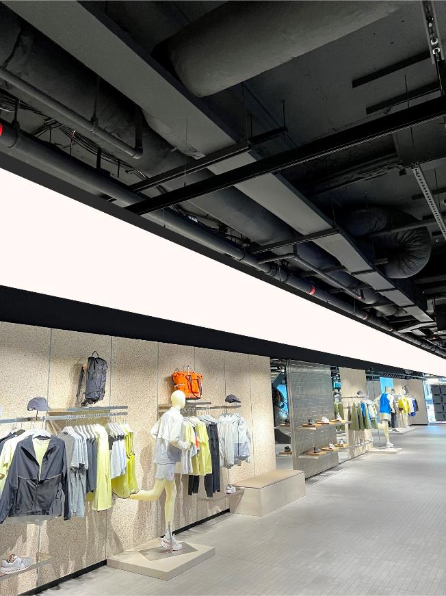
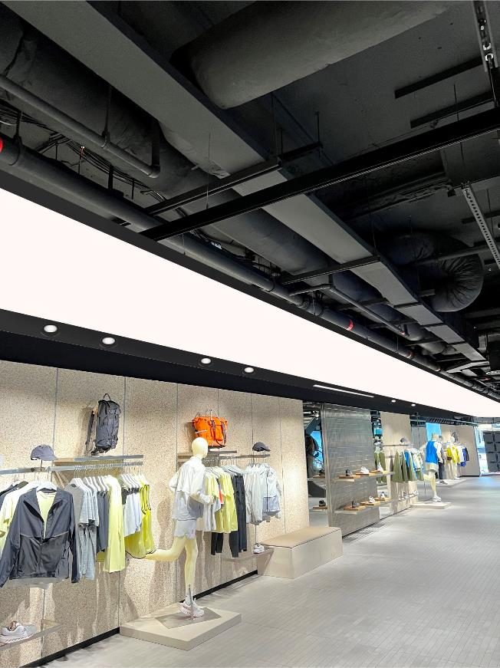
3 WAYS TO DELIVER IMMERSIVE ILLUMINATION
Cooledge FABRILum
Cooledge SkySpan
Cooledge SkyLine
Notes:
Speaker Notes:

Slide 28
SkyLine + Furtivo
Notes:
Speaker Notes:

Slide 29
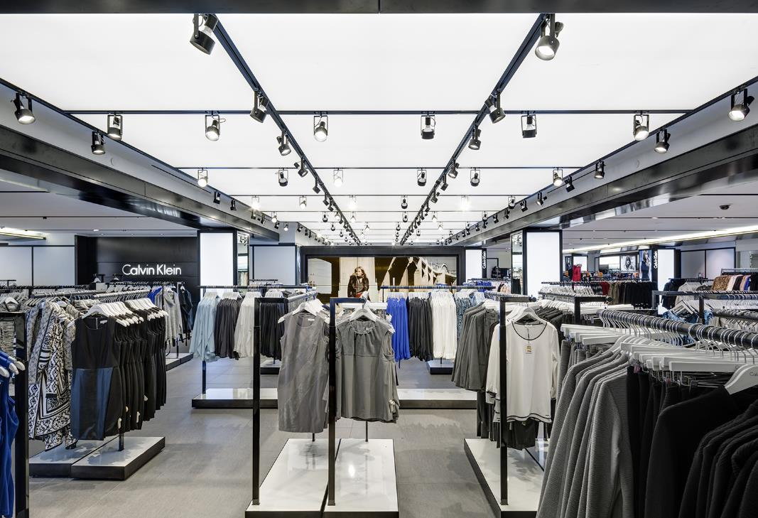

Eliminating the clutter: perfectly planar
Lighting designers’ ultimate desire is to have light magically appear to illuminate spaces with “hidden” sources that can’t be seen.
SkyLine with Furtivo and other recessed luminaires enables “perfectly planar” aesthetics while maintaining the ability to aim the lighting exactly where it is needed.
Notes:
Speaker Notes:

Slide 30
Furtivo = stealthy illumination
Perfectly Planar
Stays Flush to the Surface
= a “Perfectly Planar” aesthetic
Fully Adjustable
±40° Tilt for Floor to Ceiling Accents
360° Pan (continuous)
Fully Integrated
Ships installed in SkyLine
Uniform Beam
All 10 sources act as one
Low Glare (UGR < 10)
= Visual Comfort at Every Angle
Furtivo
Stealthy Illumination

Slide 31
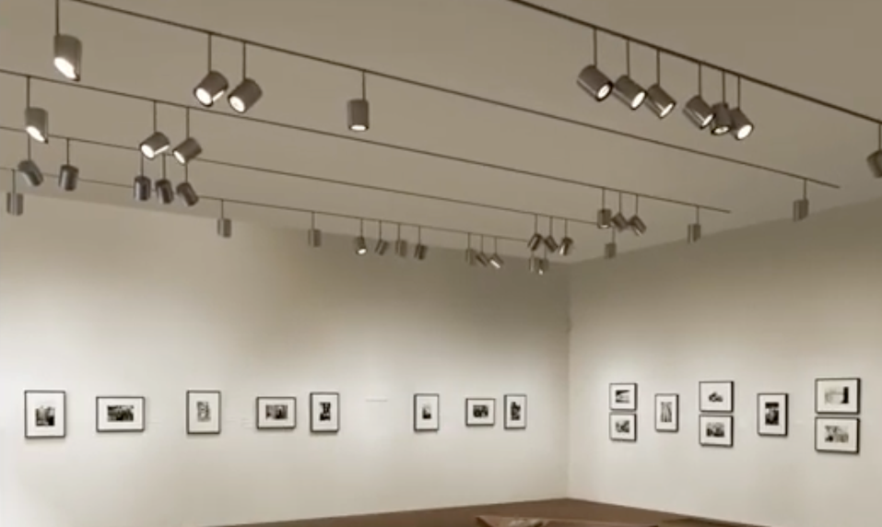
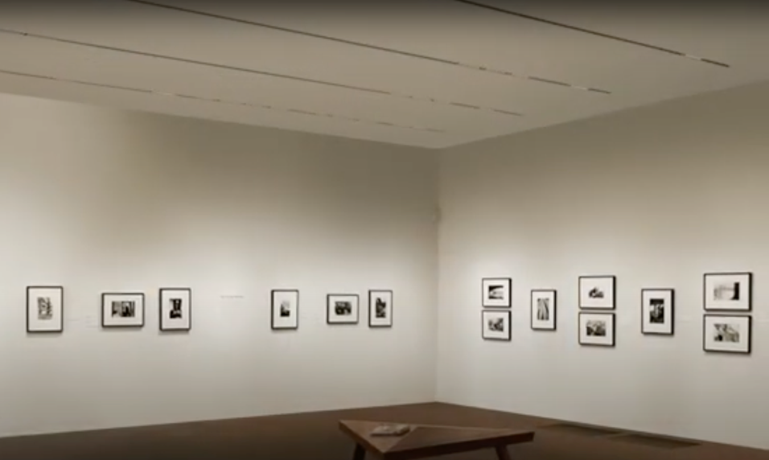
STEALTHY lighting: the perfectly planar aesthetic

Slide 32
Some product details
Notes:
Speaker Notes:
We’ve talked about the Cooledge Advantage – especially with regard to immersive illumination and acoustic performance
Time to look at our products in more detail

Slide 33
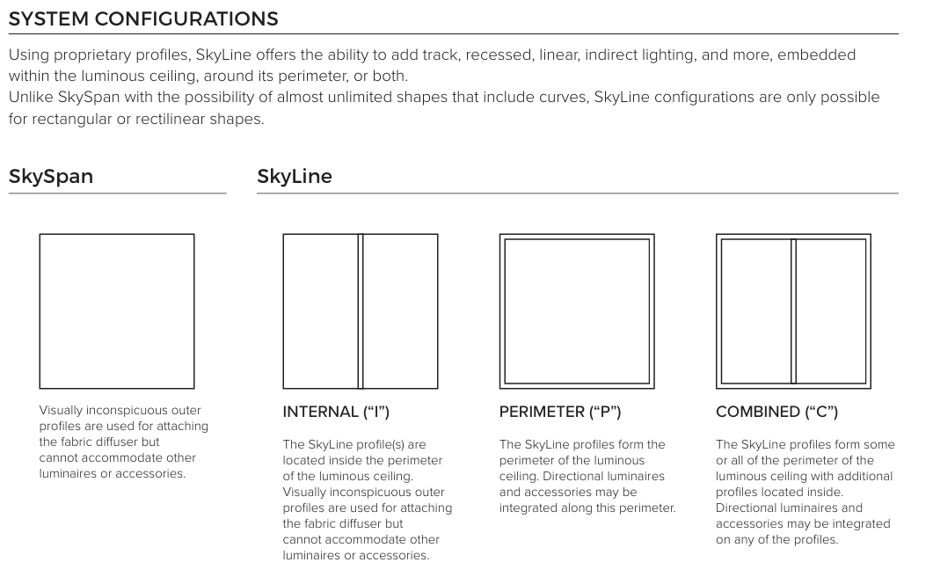
Skyline overview: configurations
Notes:
Speaker Notes:

Slide 34
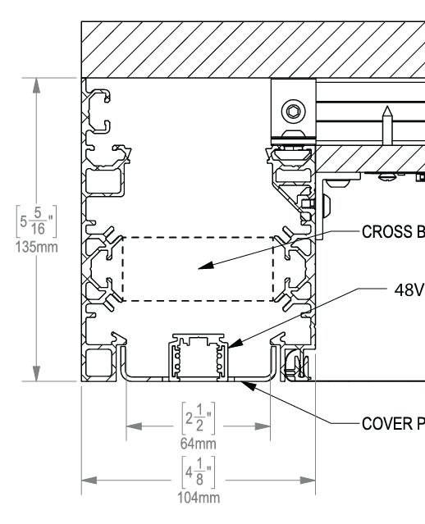
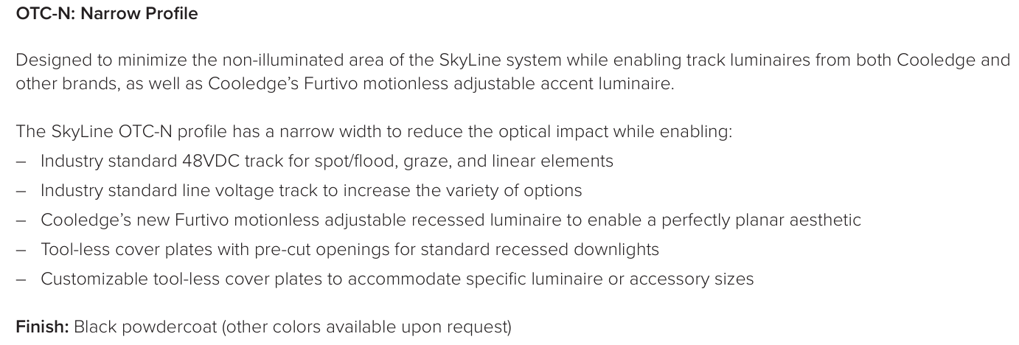
Skyline overview: Channel Widths
Notes:
Speaker Notes:

Slide 35


Skyline overview: Channel Widths
(Service Channel)
Notes:
Speaker Notes:

Slide 36

Skyline overview: system details
2 Profile Types
Perimeter: Flat outer surface (5.3”/135mm) height
Internal: Details to accommodate system components
Notes:
Speaker Notes:

Slide 37

Skyline overview: system details
Notes:
Speaker Notes:

Slide 38

Skyspan > skyline
SkySpan 01
SkySpan 02
SkySpan 03
SkySpan 04
Notes:
Speaker Notes:

Slide 39


Skyspan > skyline
SkySpan 01
SkySpan 02
SkySpan 03
SkySpan 04
Notes:
Speaker Notes:

Slide 40

Skyline overview
 | SkyLine
Mounting | Suspended and surface mount
Suspension system | Threaded rod or Aircraft cable
Curved | NO, only straight pieces
Lighting System | SkySpan offering
Colors | Black is standard and White possible longer lead-time
Channel widths | 2½” / 64mm and 5 1/16” / 128mm
Corner pieces | L-corner, T-Corner and X-corner
Cover Plates | 30 cm / 11.8”, 60 cm / 23.6” and 120 cm / 47.2”
Pre-mounted | 48V Track (Stucchi EVO line) 120cm / 47.2” Mains Track (Stucchi One Track) 120cm / 47.2” Furtivo (Cooledge) 60cm / 23.6” Sprinkler pass through 30cm / 11.8” …
Channel module | 2 different heights and maximum length 2.4m/7.8ft/94.4” Outside frame: 135mm/ 5 5/16” Inside frame: 105mm / 4 1/8”
Power & Controls | Remote mounted or attached to frame
Notes:
Speaker Notes:

Slide 41




Skyline overview
11.8” x 2.5” / 300 x 64mm
23.6” x 2.5” / 600 x 64mm
47.2” x 2.5” / 1200 x 64mm
11.8” x 5 1/16” / 300 x 128mm
23.6” x 5 1/16” / 600 x 128mm
47.2” x 5 1/16” / 1200 x 128mm
Cover Plates (see next slide)
Corners pieces are pre-assembled and have fixed dimensions.
For both widths.
Corners
Different configurations depending on configuration. Internal / Perimeter / Combined
Outside and inside different heights.
Max. length of channel = 94.4” / 7.8’ or 2400mm
Channel
Notes:
Speaker Notes:

Slide 42

Skyline overview
Notes:
Speaker Notes:

Slide 43

Skyline tracks
Notes:
Speaker Notes:

Slide 44

Skyline tracks
Notes:
Speaker Notes:

Slide 45

Skyline tracks
Notes:
Speaker Notes:

Slide 46





Skyline: Furtivo recessed
Notes:
Speaker Notes:

Slide 47


More illumination options
Additional light output options allow the designer to exactly match illuminance levels to energy code requirements
(3000K, 3500K, 4000K, and TNW 2700-5700K only)
A warmer version of Tunable White for hospitality and related applications
Notes:
Speaker Notes:

Slide 48
The new Cooledge product portfolio
Notes:
Speaker Notes:
We’ve talked about the Cooledge Advantage – especially with regard to immersive illumination and acoustic performance
Time to look at our products in more detail

Slide 49



Cooledge has a solution for every ceiling and every budget
Luminous Ceilings
Acoustic Luminaires
Lighting Systems
Luminous ceilings bringing the feeling of the outdoors to interior spaces that include general lighting, supplemental lighting, stretch ceiling materials, and installation
Large-scale luminaires that combine the value of immersive illumination and exceptional acoustic performance in out-of-the-box formats familiar to any customer, designer, or installer
Complete illumination systems that provide superior quality backlighting for virtually any large area luminous surface incorporating materials such as glass, polymers, and translucent stone
Cooledge combines “Immersive Illumination” with “True Acoustic Performance” = the best of two worlds
Using light as a building material is a REVOLUTIONARY change from traditional points and lines added as an afterthought to integrated luminous surfaces that are integral to building design
Notes:
Speaker Notes:
Cooledge offers three levels of products from complete turnkey solutions to lighting systems
At the highest level, we offer full luminous ceilings that include general lighting in the form of a fabric stretch ceiling, supplemental lighting, and installation in one solution
Our architectural acoustic luminaires deliver immersive illumination in a large scale format familiar to any customer, designer, or installer
Complete illumination systems that provide superior quality backlighting for virtually any large area luminous surface incorporating materials such as glass, polymers, and translucent stone

Slide 50



Products: luminous ceilings
Notes:
Speaker Notes:
Cooledge offers the most comprehensive portfolio of large format illumination products in the market
The primary product lines are: Specialty Illumination Solutions (SIS); FABRILum, and TILE lighting systems

Slide 51

Cooledge’s new adjustable (Stealthy) luminaire

Slide 52


Products: acoustic luminaires
Notes:
Speaker Notes:
Cooledge offers the most comprehensive portfolio of large format illumination products in the market
The primary product lines are: Specialty Illumination Solutions (SIS); FABRILum, and TILE lighting systems

Slide 53


Products: lighting systems
Notes:
Speaker Notes:
Cooledge offers the most comprehensive portfolio of large format illumination products in the market
The primary product lines are: Specialty Illumination Solutions (SIS); FABRILum, and TILE lighting systems

Slide 54
THANK YOU

